Slide 1
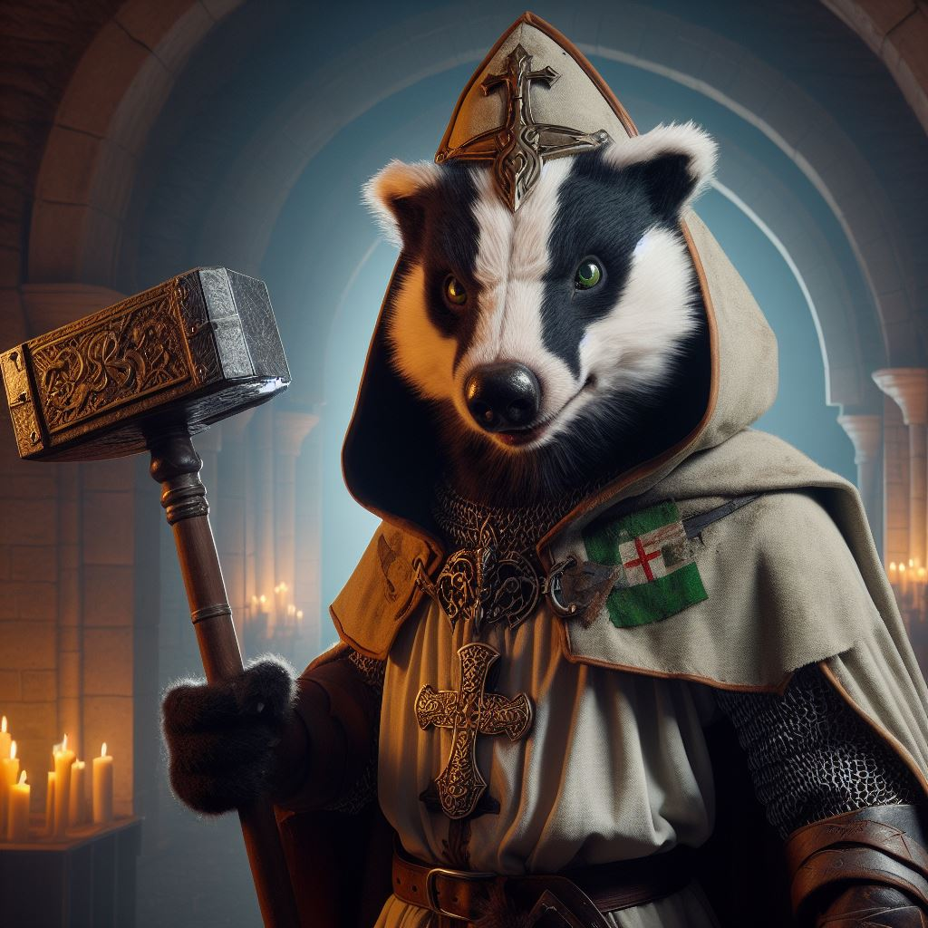
Mydain
The Mydain are wise and stout members of the digger classification of the Kind. While short tempered they are also very loyal to their friends and will not hesitate to aid them despite overwhelming odds. Spats with a Mydain are short lived with those they respect, they do not hold grudges and would be likely do go have an ale with someone they were sparring with earlier that day.
The Mydain are relentless in battle and make formidable foes. They are naturally adept at working underground or in dimly lit places. They are experts at ambush and may dig small holes to lie in wait.
Baagalaag, Mydain Cleric investigating a noise in the temple cellars
Mydain Traits
Ability Score Increase: Your Constitution increases by 2, wisdom increases by 1
Age. Mydain generally live up to 100 years and mature around the age of 12.
Diet: Mydain are omnivorous
Alignment. They tend to be more neutral than not but can lean either toward lawful or chaotic.
Size. Your size is Medium. You range between 4-5 feet tall and weigh around 85-150 lbs.
Speed. Your base walking speed is 25 feet. You are able to dig in soft earth, but not stone at 10’ per round
Reach. Your reach is 5’
Darkvision. You can see in dim light within 60 feet of you as if it were bright light, and in darkness as if it were dim light. You can’t discern color in darkness, only shades of gray.
Claws. As your attack action you may make 2 unarmed strikes with their sharp claws for 1d4+strength bonus if hand is unoccupied
Powerful Bite. As part of your attack action you may choose to bite for 1d6 + strength
Grounded. Your connection with the earth gives you resistance to lighting damage.
Serpent Bane. You have advantage to attack rolls against serpentine creatures
Short legs. Mydain have disadvantage on acrobatics checks
Long Claws. Your long digging claws give you disadvantage to sleight of hand checks

Slide 2
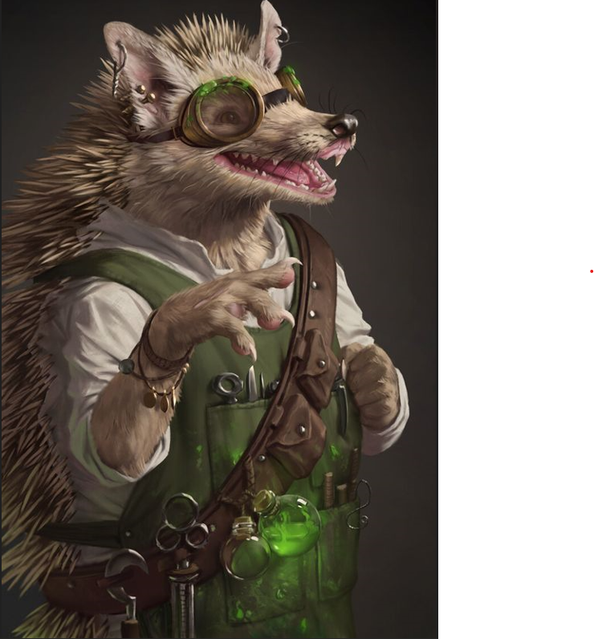
Quillian
The Quillian folk equipped with their own natural defense can be a frustrating adversary. They are a jovial race and find humor in most situations, especially shopping in crowded streets. They enjoy entertaining others and many of their kind become bards or even jesters.
Their temperament is very even keeled, they are very hard to upset. Their homes tend to be in vast underground areas with other diggers whose company they tend to prefer.
It is rare to find an evil Quillian as most tend to prefer to be productive members of society and working with others in supportive roles.
Quillian Traits
Ability Score Increase: Your Strength increases by 1, Charisma by 2
Age. Quillian generally live up to 100 years and mature around the age of 15.
Diet: Quillian are omnivorous
Alignment. Quillian tend toward good alignments
Size. Your size is Small. You range between 3-4 feet tall and weigh around 50-80 lbs.
Speed. Your base walking speed is 25 feet. Dig in soft earth at 10 feet
Reach. 5’
Spines. A creature that attempts to grapple you has disadvantage on ability checks to do so. Whenever a creature successfully grapples you, and each time you use your action to try to escape, that creature takes 1d4 piercing damage. A creature that engulfs you, such as by swallowing, takes 3d4 piercing damage at the end of each of its turns that it continues to do so.
Spiney Norman, Quillian Artificer adorned with tools of his trade
Darkvision. Accustomed to night life, you have superior vision in dark and dim conditions. You can see in dim light within 60 feet of you as if it were bright light, and in darkness as if it were dim light. You can't discern color in darkness, only shades of gray.
Keen Nose. When using your sense of smell to attempt Wisdom (Perception) checks, you can add your proficiency bonus. If you have proficiency in Perception, your proficiency bonus is doubled for this purpose.
Ball up. When you drop prone, you can roll into a ball that causes your spines to protrude. While you’re prone, other creatures do not gain advantage on attack rolls against you if they are within 5 feet of you.
Buoyant. You gain advantage on ability checks to remain afloat. You can swim, but at half movement
Spikey woe. Quillian have disadvantage to acrobatics as their quills tend to get in the way.

Slide 3
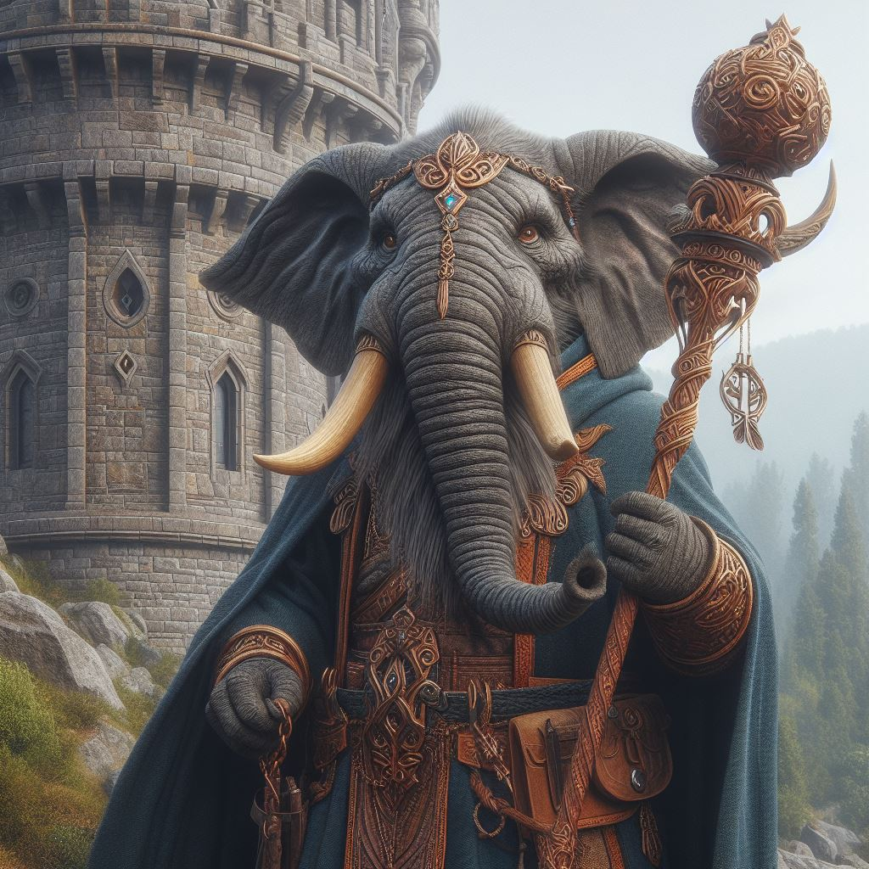
Loxodon
The thick skinned Loxodon is one of the two Geishnan races of the Kind. More gentle and bright than their cousins they are more prone to overthink before they act. They are very good at planning sessions but may be paralyzed by indecision in critical moments.
The Loxodon kind has mastered the nature of stillness and calm, but can be ferocious when enraged. His mind is like a steel trap, allowing him to remember details like no other.
The attachment of the family structure for the Loxodon is similar to the Mastor and they enjoy a close community and family structure.
ZinDraj, Loxodon Sorcerer outside of COW near the city of Hintergedanke
Loxodon Traits
Ability Score Increase: Your Wisdom increases by 2, Constitution increases by 1
Age. Loxodon generally live up to 450 years and mature around the age of 30.
Diet: Loxodon are herbivorous
Alignment. Loxodon tend to have a more lawful view of life and find structure to be a necessary part of life.
Size. Your size is Large. You range between 7-9 feet tall and weigh around 300-400 lbs.
Speed. Your base walking speed is 30 feet.
Reach. Your reach is 5’
Overthinker. Loxodon are vulnerable to psychic damage and are at disadvantage to such attacks
Potent Proboscis. As a bonus action you may make an attack with your trunk in attempt to grapple an opponent. You may also chose to hold object in your trunk within 5’ of you as a free action. Wands etc. may be activated while held in this fashion.
Strong mind. Your keen mind allows you to cast and maintain two concentration spells at the same time. Each check is rolled separately.
Keen hearing. Your large ears make you very difficult to sneak up on, you gain advantage for any checks requiring hearing and your passive perception is at +3
Thick hide. You have resistance to fire based damage and +2 to AC
Hyperthymesia. Loxodon have advantage on wisdom checks for recalling places, people events or thoughts.

Slide 4
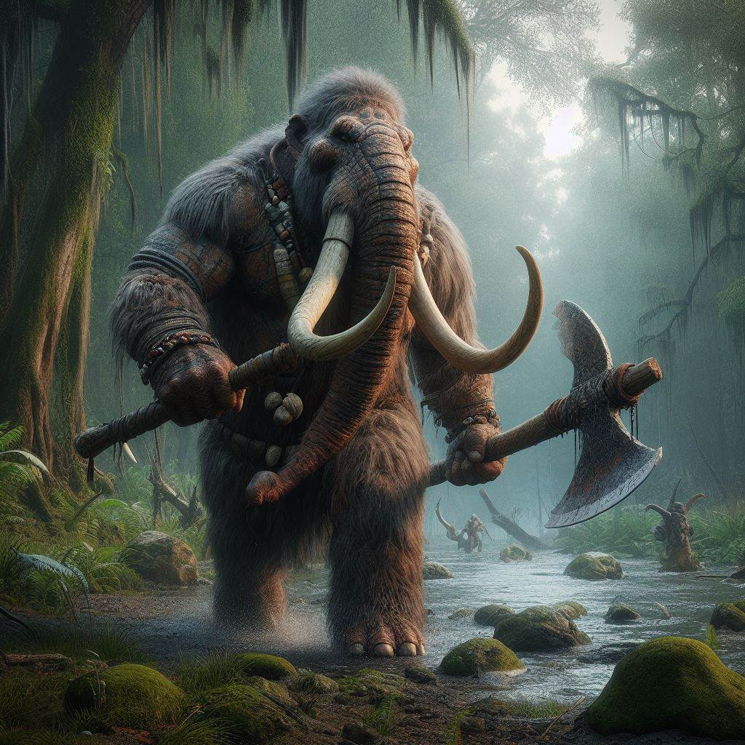
Mastor
The Shaggy Mastor is one of the two Geishnan races of the kind. More brutal and slightly more dimwitted than their cousins they are more prone to act before they think. Not great at planning or following rules they prefer to be able to react to any given situation quickly without being concerned over right or wrong.
Their long fur makes them more versatile in colder climates, while food is scarcer they feel more at home. They have strong family values and as such will aid another of Geishnan if they are able. They tolerate other races well, but do tend to live in smaller communities with other Mastors. While able to wear armor, most do not like it as it tends to impede their already slower reactions. They simply do not have time for finesse and prefer brute force in their weapon selections.
Agrath, Mastor barbarian returning to his home in marshmire swamp
Mastor Traits
Ability Score Increase: Your Strength increases by 2, Constitution increases by 1
Age. Mastor generally live up to 350 years and mature around the age of 22.
Diet: Mastor are herbivorous
Alignment. Mastor tend to have a more chaotic view of life and find structure to be cumbersome.
Size. Your size is Large. You range between 9-11 feet tall and weigh around 400-600 lbs.
Speed. Your base walking speed is 30 feet.
Reach. Your reach is 10’
Tusks. As a bonus action you may make an attack with your tusks for 1d8 + Proficiency + strength points of damage. Reach 5’
Brute Force. You gain advantage on Athletic checks
Thick Fur. You have advantage to survival checks in cold situations, but disadvantage to heat based ones.
Charge. If moving 15 feet or more you may make a charging attack (Grapple check) opponent failing check is knocked prone and takes 2d6 + strength bonus for damage
Lumbering Hulk. You have disadvantage on Acrobatic checks
Family First. If a companion falls prior to your turn your next attacks are done with advantage.

Slide 5
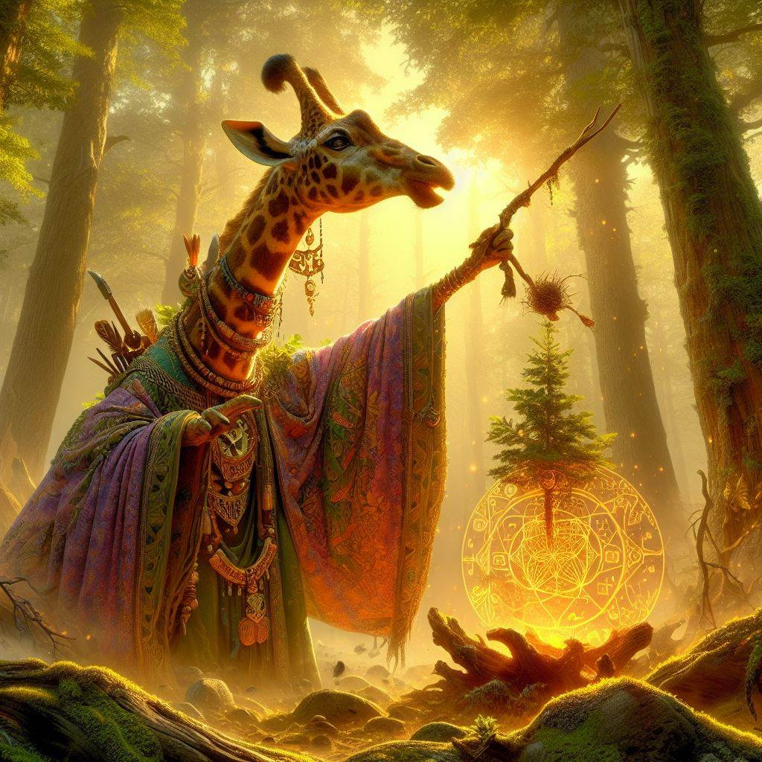
Ungulate
These gentle folk often live away from the hustle and bustle of the big cities. While they are quite capable in battle they often prefer a less direct approach. They choose their actions with careful consideration and always aspire to make right choices. Their lifestyle tends to be nomadic, seeking knowledge in all things and following a path that they themselves cannot always see. This lifestyle makes it difficult to locate a particular member of the species as they are typically never in one place for more than a few months.
They travel the lands as scholars and advisors with their brightly colored clothing and long necks they are not someone that can easily be missed. They are soft spoken as a people and slow to anger, and as such often are good with slow deliberate negotiations.
Mardaaon, Ungulate Sorcerer performing an invocation in the Moss Wood Forest.
Ungulate Traits
Ability Score Increase: Your Wisdom Score increased by 2 and your intelligence by 1
Age. Ungulates generally live up to 111 years and mature around the age of 12.
Diet: Ungulates are Herbivorous
Alignment. Ungulates generally steer away from Evil alignments, tending toward good and law but it is not uncommon to have some on the chaotic side.
Size. Your size is Large. You range between 10-12 feet tall and weigh around 600 - 800 lbs.
Speed. Your base walking speed is 35 feet.
Reach. Your reach is 10’
Telescopic Neck. Due to the length of your neck, you can see further and better than most. You have advantage on Perception Checks using Sight and your Passive Perception gains a bonus of +2.
Peaceful Soul. With the wisdom of the elders comes a stillness of the soul. Twice per long rest you may end an effect upon yourself at the start of your turn
Strong Mind. Your Ungulate linage provides you resistance to Psychic damage.
Enlightened Mind: You may chose proficiency in either Arcana, Religion or History
Awkward Movements: being large and gangly your kind finds it difficult to perform acts of stealth and suffers disadvantage when trying to hide or approach with discretion

Slide 6
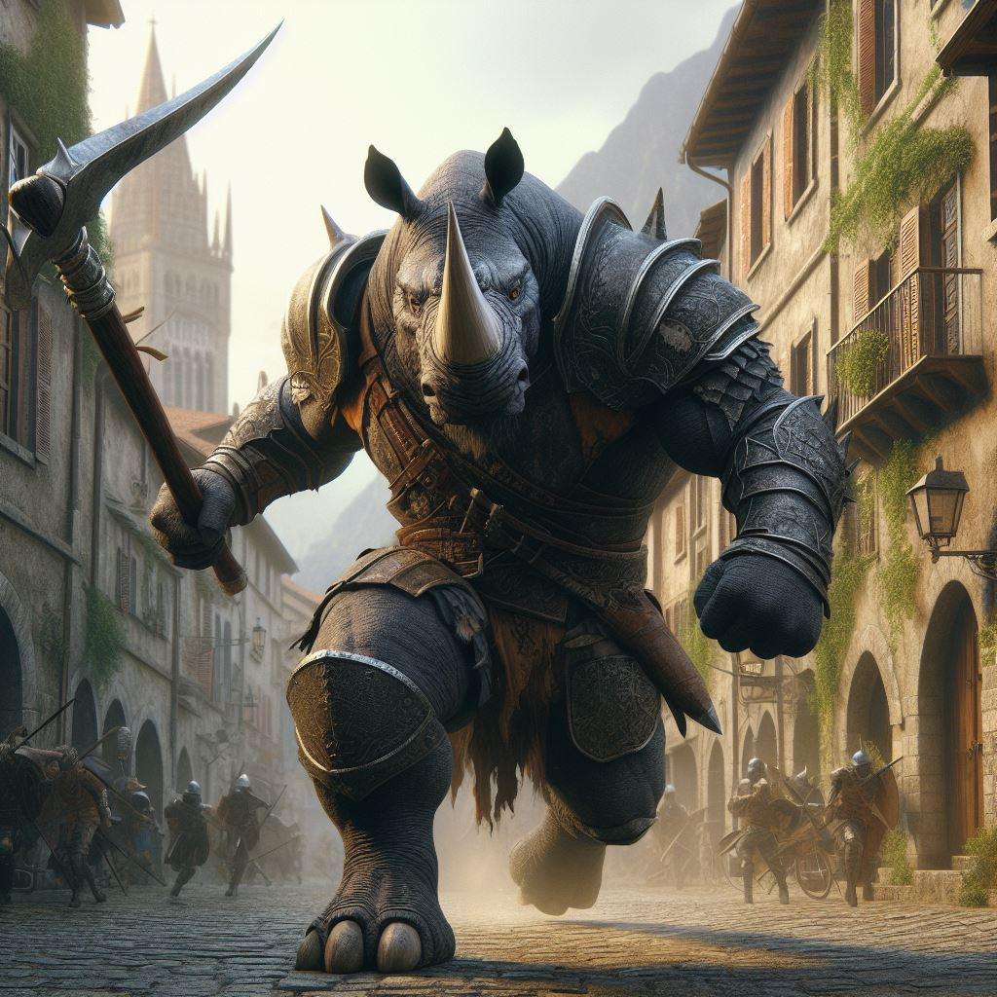
Rhinomite
These large beings are slow witted but quick to violence. Their brute force is hard to overcome and they are often employed at city guards or bouncers at the best taverns.
The nearsightedness of their kind means that they are often startled and quick to react. A short charge from an angry Rhinomite is not a good way to start your day. Conversations with these beings can be a challenge, they do not have a solid grasp on complex problems and would rather resort to violence to solve a situation.
They tend to be loners as too many gathered together will often end in misunderstandings and collateral damage, the young leaving home often before full maturity. They are faithful to their friends, as long as they don’t use too many big words they find offensive.
Gratham, Rhinomite Battle Master rushing to defend the gates of Contumacious
Rhinomite Traits
Ability Score Increase: Your strength increases by 1 and your constitution by 2
Age. Rhinomites generally live up to 400 years and mature around the age of 17.
Diet: Rhinomites are Herbivorous
Alignment. Rhinomites tend toward the chaotic side of life, finding that a lawful existence is often too restrictive for their rambunctious lifestyle.
Size. Your size is Large. You range between 6-9 feet tall and weigh around 750 - 1000 lbs.
Speed. Your base walking speed is 30 feet.
Reach. Your reach is 5’
Poor eyesight. Your vision is not great, and as such you have disadvantage on Perception Checks using Sight and your Passive Perception has a detriment of -2.
Quick anger. Easily provoked a Rhinomite has disadvantage to any taunting effects or spells and must make a perception check (DC 15) to resist jibes that are intended to provoke
Thick skin. Your base AC increases by 2.
Horny Beast: Horn attack starts at 1d6 + strength as part of a normal attack action. Reach 5’. Increases by 1d6 at 3rd, 6th and 9th
Living Plow: if the Rhinomite moves more than 15 feet it can charge an opponent, using its horny beast ability at double efficacy
Big personality: Rhinomites have proficiency in intimidation

Slide 7
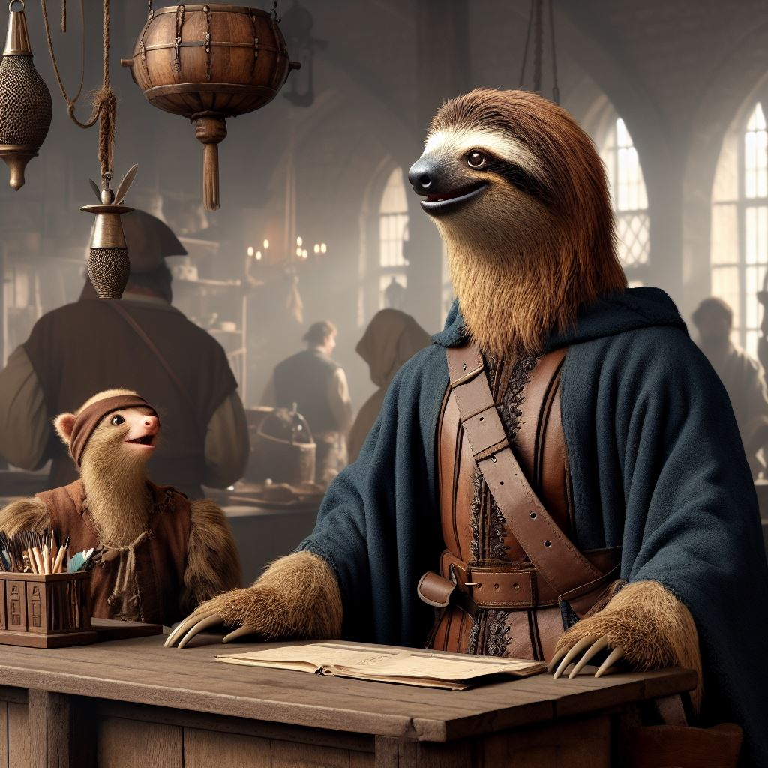
Sloven
Slow and steady wins the day in the mind of the Sloven kind. Though they are not weak fighters in combat but many of the Sloven rely on the strength of their minds to see them through conflict situations. As crafters they are meticulous and detailed, some of the finest silversmiths and jewelers are among their kind.
They tend to be a peaceful people and would rather spend time learning and studding that wandering around the countryside. It is rare to find one out as an adventurer and can often frustrate the groups they are with because of the pace they set for themselves. Getting a Sloven to get to a point in negotiations or conversation can often be more challenging than most would want to deal with.
Hethle, Sloven Cartographer with his assistant Fetterday
Sloven Traits
Ability Score Increase: Your Wisdom increases by 2, Intelligence increases by 2
Age. Sloven generally live up to 750 years and mature around the age of 50.
Diet: Sloven are herbivorous
Alignment. Sloven tend toward the good alignments, but there have been rare evil Sloven throughout Thera
Size. Your size is Medium. You range between 5-6 feet tall and weigh around 125-200 lbs.
Speed. Your base walking speed is 15’ feet.
Reach. Your long arms have a reach of 10’
Slow Metabolism. You have resistance to poison damage
Darkvision. Accustomed to night life, you have superior vision in dark and dim conditions. You can see in dim light within 60 feet of you as if it were bright light, and in darkness as if it were dim light. You can't discern color in darkness, only shades of gray.
Meditative Mind. You have advantage on all Wisdom or Intelligence saves
Slow as F. Sloven have disadvantage on all Dexterity or Charisma saving throws and proficiency checks
Deliberate Movement. No class abilities, skills or feats can increase your movement rate.

Slide 8
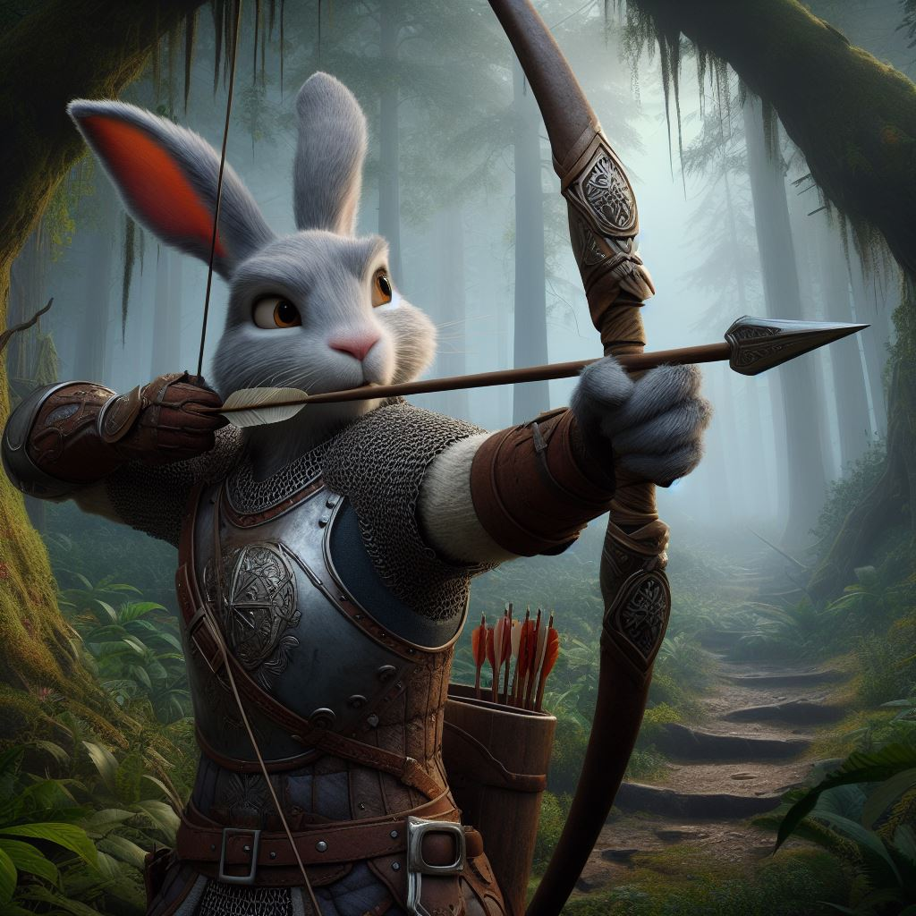
Hasenpfeffer
Quick and agile, the Hasenpfeffer is a reliable ally in any situation. They are excellent bowmen and quick with a rapier moving deftly throughout the field of battle. Some of the best bowyers and fletchers are members of their race, having intimate understanding of the woods and strings they use to produce top notch archery equipment..
They tend to be a peaceful but enjoy a good jaunt around the countryside. Sometime the Hasenpfeffer don’t think things through as well as they should and their haste can often get them into trouble. As companions they are faithful to the end, they recognize a valuable arrangement when they can and strive to live up to their own high standards in their groups. They tend to have large families with many children at early ages.
Bugs, Hasenpfeffer ranger testing out his newly crafted bow
Hasenpfeffer Traits
Ability Score Increase: Your Dexterity increases by 2, Charisma increases by 1
Age. Hasenpfeffer generally live up to 80 years and mature around the age of 8.
Diet: herbivorous
Alignment. Hasenpfeffer tend prefer an organized group and therefore lean toward lawful
Size. Your size is Medium. You range between 4-5 feet tall and weigh around 60-90 lbs.
Speed. Your base walking speed is 35’ feet.
Reach. 5’
Quick reflexes. You have advantage to dexterity saves
Darkvision. Accustomed to night life, you have superior vision in dark and dim conditions. You can see in dim light within 60 feet of you as if it were bright light, and in darkness as if it were dim light. You can't discern color in darkness, only shades of gray.
Paranoid. Your alert nature allows you to add 2 to your passive perception and you gain proficiency in perception
Burst of speed. Thrice per long rest you may double your movement in a turn
Skittish. You have disadvantage against intimidation.

Slide 9
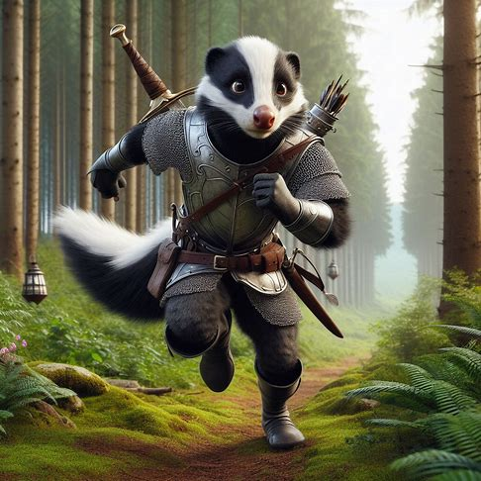
Skunkee
The Skunkee kind tend to be quite reclusive, not necessarily by choice. While they are friendly and outgoing the odor that lingers nearly ever present around them tends to be a bit too much for most people to deal with. They often will find positions that are more independent, such as a Ranger, mercenary or even assassin.
They are an even tempered folk, but can have a little bit of an attitude if others start becoming derogatory. The Skunkees are quite resourceful and quick witted when it comes to problem solving, but do not make for good negotiators. If you can tolerate or get used to the persistent odor they are actually quite handy to have on your side.
The degree of white and black varies for the Skunkee, from nearly all back with spots to a full white back. They are quite proud of their tails and normally keep them immaculately brushed.
Pepe, Skunkee Hunter relentlessly pursuing a marked victim
Nocturnal. Primarily out at night, Skunkees have Darkvision of 90’
Musk The Skunkees may launch a spray as a bonus action, 5’ wide by 20 feet long 3 times per long rest. Targets must make a DC 15 con save or be prone and incapacitated (retching). May make a save at the end of each of its turns to regain composure. The smell will linger for 3d4 days.
Upwind Ninjas. When approaching upwind from a target or in still air the Skunkees have advantage on stealth checks. When downwind or when the air is turbulent they have disadvantage on all stealth checks
Marked. Any creature targeted by the Musk may be tracked with advantage on all rolls for the duration of the smell, even if the creature saved.
Natural Trackers. Skunkees gain proficiency in the survival skill, if they are of a class that gets this skill it becomes expertise.
Gagable Gab. The Skunkees companions within 30’ suffer disadvantage when using the persuasion skill
Skunkee Traits
Ability Score Increase: Your Dexterity increased by 2, wisdom and intelligence increase by 1
Age. Skunkees generally live up to 125 years and mature around the age of 13.
Diet: Skunkees are omnivorous and enjoy a good bowl of grub(s)
Alignment. Skunkees tend toward the lawful side of life, but it is not unheard of to find a rogue Skunkee skirting the edges of society.
Size. Your size is Medium. You range between 5-6 feet tall and weigh around 125-180 lbs.
Speed. Your base walking speed is 30 feet.
Reach. Your reach is 5’
Stench. Skunkees suffer disadvantage on any Charisma based checks or saving throws

Slide 10
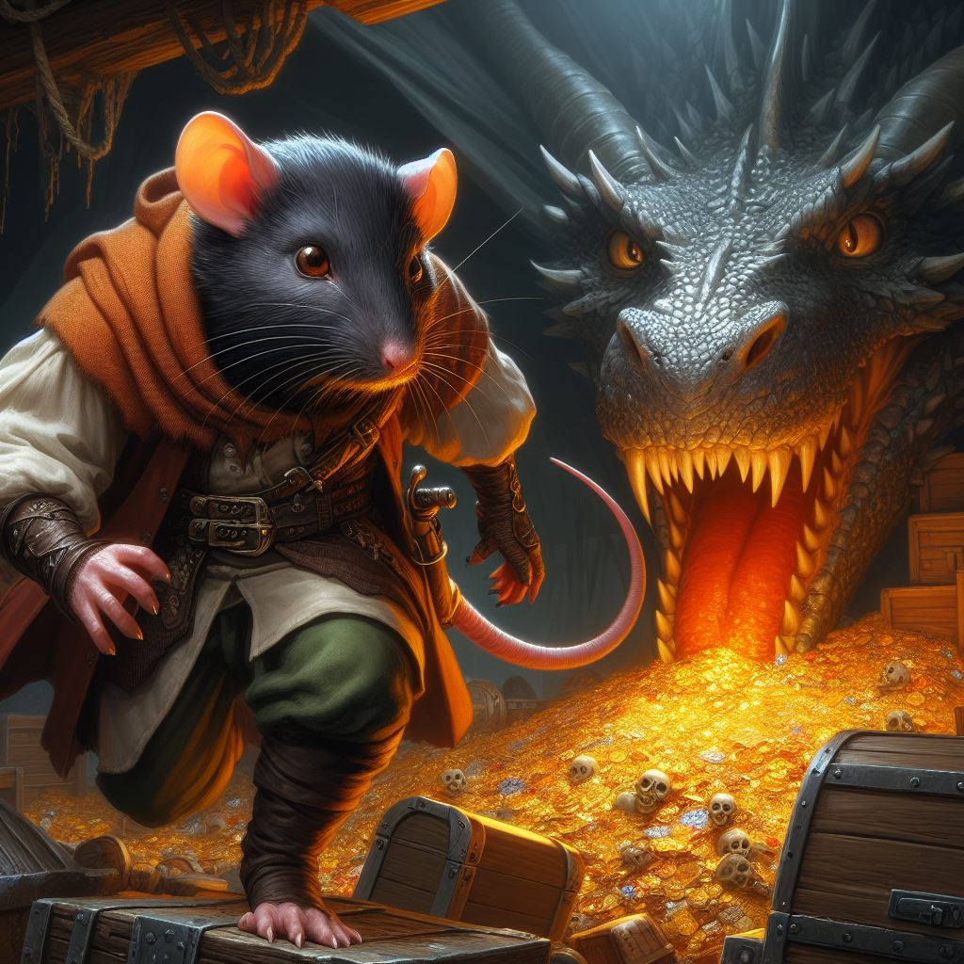
Rattus
Rattus live brutal lives where survival takes precedence over everything else. They don’t shy away from sinister powers or abilities. Some Rattus become deadly assassins, mastering wicked crafts. Others spread plagues or command vermin swarms. Even those who pursue power through conventional martial means use fear and underhanded tactics to achieve their goals
Rattus communities can be found in and around large urban areas. These communities tend to be eclectic and diverse, with those of rat folk ancestry welcoming others to join them with open arms. Indeed, their communities collect not only members but virtually anything they can find, with members often patrolling the cities in which they live and bringing back piles of junk to repurpose. To outsiders Rattus communities often resemble piles of trash, but they tend to find the clutter comforting, despite the refuse and garbage they collect, the community members themselves are as clean as any other citizens of the city.
Rizzo, Rattus Swashbuckler decides that he needed to reconsider his approach
Iron Stomach. You can eat virtually anything without concern. You have advantage on saving throws against poison, and resistance to poison damage
Heightened Smell. You have advantage of perception checks that rely on smell
Perseverance. You have proficiency with the survival skill
Resourceful. when searching through piles for valuables you have advantage on checks
Hard to kill. Rattus start with the toughness feat
Tactical fighters. In face to face combat Rattus suffer disadvantage to attack rolls. A hit and run strategy is always preferable to these folks An attack of opportunity by enemy movement or surprise isn’t negatively impacted.
Rattus Traits
Ability Score Increase: Your Dexterity increases by 2, Intelligence by 1
Age. Rattus generally live up to 90 years and mature around the age of 10.
Diet: Rattus are omnivorous
Alignment. Rattus tend to lean toward the evil side of things as a whole, but some noble examples strive for justice
Size. Your size is small. You range between 4-5 feet tall and weigh around 60-120 lbs.
Speed. Your base walking speed is 25’ feet.
Reach. 5’

Slide 11
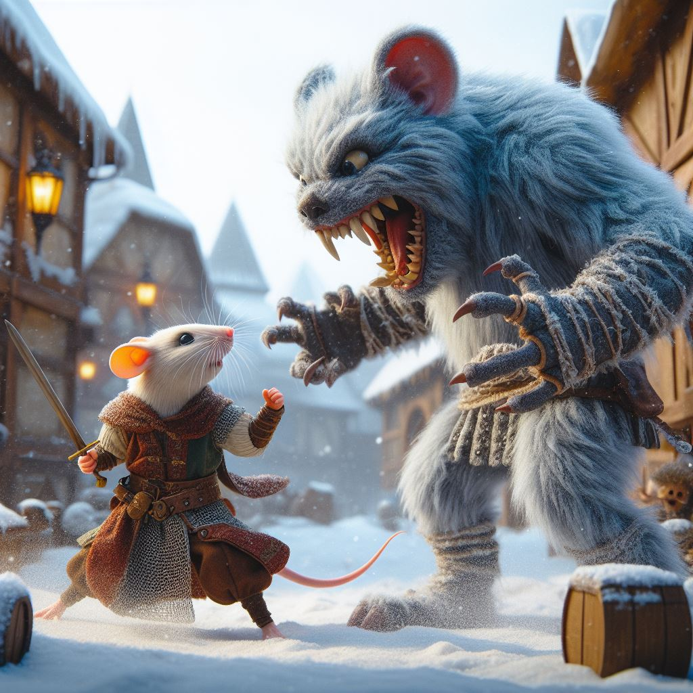
Muridae
Muridae, are diminutive humanoid creatures characterized by their small, fur-covered bodies, long prehensile tails, large ears, and sharp senses. Agile and resourceful, they thrive in underground communities, utilizing their keen intelligence and dexterity for tasks like thievery, scouting, and tinkering with mechanical devices.
They can quickly squeeze into tight crevices to escape attackers, which gives them an advantage in their claustrophobic underground homes. Muridae excel in roles requiring nimbleness and quick thinking.
They are community minded in their underground homes and understand that it is critical to their survival to stick together. They have an affinity for small shiny objects and their homes are often decorated with quite an array of their findings and collections.
Caros, Muridae facing down a Morous that has been harassing his village
Muridae Traits
Ability Score Increase: Your Wisdom increases by 1, dexterity increases by 2
Age. Muridae generally live up to 75 years and mature around the age of 6.
Diet: Muridae are omnivorous
Alignment. Muridae tend toward lawful alignments, with an understanding that community is critical to their survival
Size. Your size is Small. You range between 2-3 feet tall and weigh around 30-50 lbs.
Speed. Your base walking speed is 20’ feet, climbing 15’
Reach. 5’
Scavenger. You have proficiency in the perception and survival skills
Darkvision. Accustomed to night life, you have superior vision in dark and dim conditions. You can see in dim light within 60 feet of you as if it were bright light, and in darkness as if it were dim light. You can't discern color in darkness, only shades of gray.
Scurry. You can fit in spaces normally too small for most creatures your size, you gain advantage to attacks when underground. You gain advantage against being grappled
Light Sensitivity. Muridae, being nocturnal creatures, struggle in bright daylight. They have disadvantage on Perception checks or attack rolls when in direct sunlight
Fragile Constitution. Their delicate frames make them more susceptible to harm. You have disadvantage on saving throws against poison or disease.
Quick reflexes. You gain advantage on acrobatics checks and dexterity saves

Slide 12
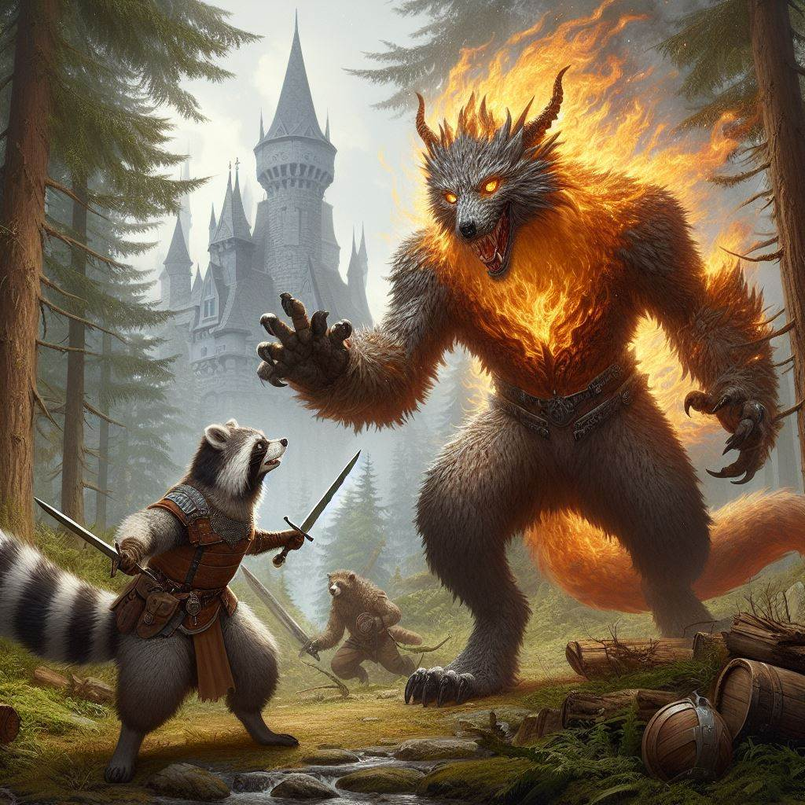
Rocasa
The Rocasa are opportunists who will not hesitate to do what they need to for survival. While not normally evil they are very concerned about self preservation and survival. Sometimes this survival can have unintentional negative impacts to others. Groups of Rocasa have been known to band together as organized mobs to accomplish their tasks, which often relates to food collection.
They can be formattable opponents in combat, relying on their agility to avoid impacts and land blows on their foes. They have a bravery unusual to their diminutive size and will not back down from even the largest of foes.
Mr. Pibbles, Rocasa rogue bravely faces the Drex that has been harassing the farmers
Rocasa Traits
Ability Score Increase: Your dexterity increases by 2 and your Intelligence by 1
Age. Rocasa generally live up to 100 years and mature around the age of 15.
Diet: Rocasa are omnivorous, but incessantly must wet their food in water before eating
Alignment. Rocasa tend to be somewhat chaotic, unpredictable and almost always curious. They are rarely evil
Size. Your size is Small. You range between 2-4 feet tall and weigh around 35-50 lbs.
Speed. Your base walking speed is 25 feet. Your base climbing speed is 20 feet. Your base swimming speed is 10ft.
Reach. 5’
Trash Panda. When it comes to rotting food, nothing non-magical you eat can make you sick. However, it only gives half as much health/nutrition as it normally would. Poisons still act as normal.
Darkvision. Accustomed to night life, you have superior vision in dark and dim conditions. You can see in dim light within 60 feet of you as if it were bright light, and in darkness as if it were dim light. You can't discern color in darkness, only shades of gray.
Fanciful Forager: You gain proficiency with two of the following skills of your choice: Perception, Nature, Stealth, Survival and Medicine
Nimble Claws. Your claws are natural weapons, which you can use to make unarmed strikes. If you hit with them, you deal slashing damage equal to ld4 which can be calculated using either your Strength or Dexterity modifier for both the attack roll and damage bonus. You are proficient with your claws.
Bandit's Determination. Rocasa have advantage on any fear based spells or effects.

Slide 13
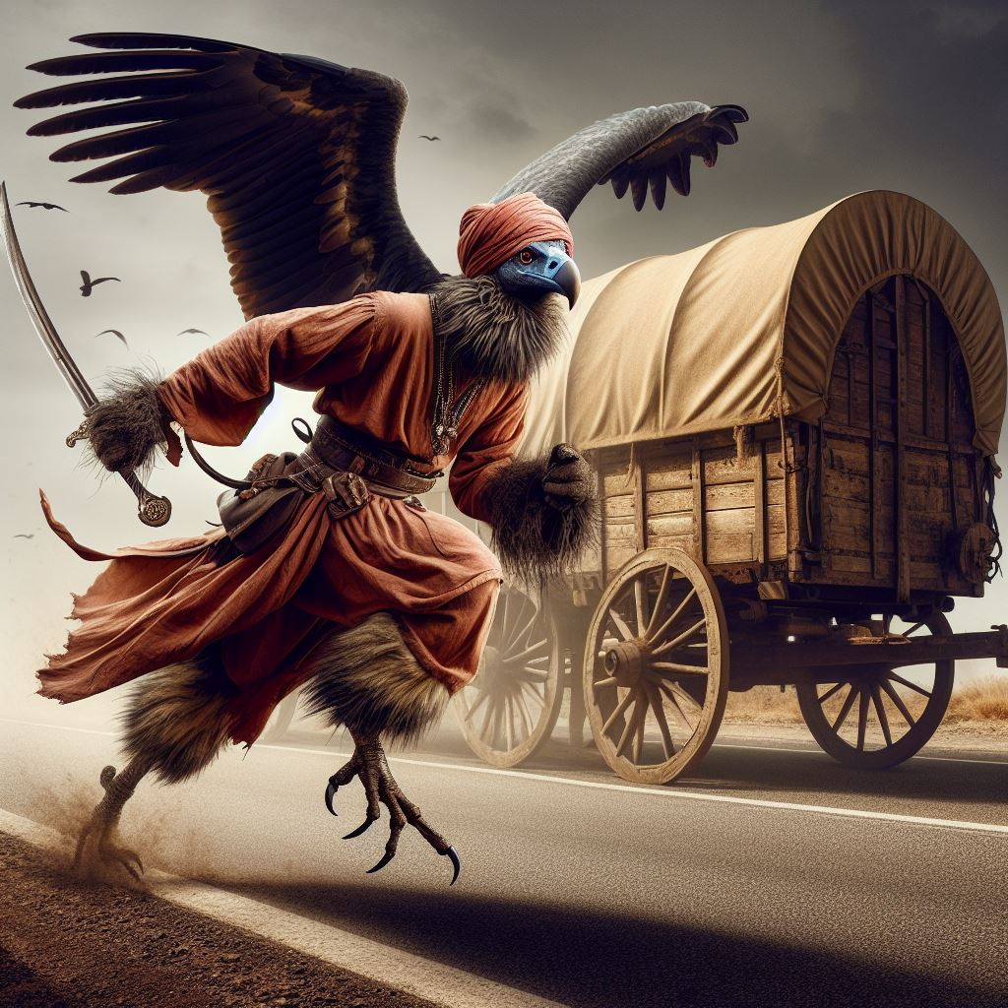
Cathartidae
One of the Aves races, the Cathartidae are relentless in battle and do not hesitate to use unscrupulous methods to turn the tides of battle. Despite their appearance they have some of the most glib tongues among the Kind. Often reclusive in nature, they will often be employed as scouts or mercenaries to accompany supply trains as they are quite effective at ensuring the safety of their charges.
When the Cathartidae do flock together it is a noteworthy event as they are quite formidable in numbers, and it is always for a greater purpose. Their eating habits do not make them the ideal dinner guests but they are shrewd negotiators.
Seth, Cathartidae warrior coming in for a landing to warn of what lies ahead
Cathartidae Traits
Ability Score Increase: Your Charisma increases by 2, constitution by 1
Age. Cathartidae generally live up to 750 years and mature around the age of 50.
Diet: Cathartidae are scavengers, preferring rotting meat over fresh
Alignment. They tend toward the more chaotic alignments, leaning toward the evil side of the spectrum
Size. Your size is Medium. You range between 5-6 feet tall and weigh around 100-130 lbs.
Speed. Your base walking speed is 30’ feet, you may also maintain a flying speed of 25’ which can not be impacted by the ‘dash’ action except in downward movement
Reach. 5’
Extreme tolerance. You have advantage on any poison saves
Shrewd negotiators. You have proficiency in persuasion and performance
Glib. You have advantage on charisma saves
Slight build. Your body is light for its size, enabling flight but giving you disadvantage against grapple Necromantic Ties. Years of your species consuming decaying flesh has given you ties to the dead. You have access to the chill touch cantrip

Slide 14
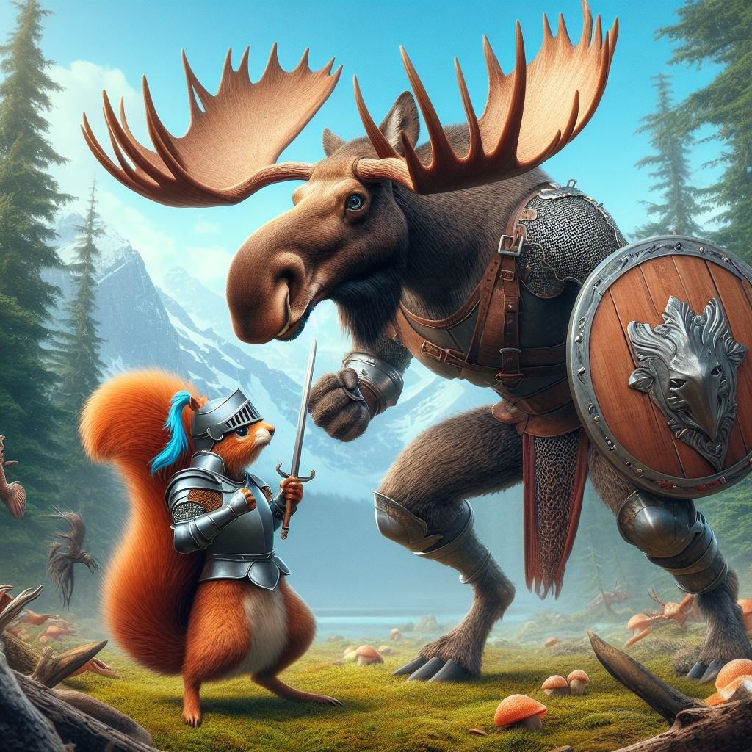
Capralces
The Capralces are generally friendly and laid-back, content to peacefully coexist with their surroundings and enjoy the fruits of its natural bounty. This does not, however, mean that they are extroverted or outgoing: their first response to most newcomers who enter their territory is to politely ignore them until the strangers either leave or come too close for comfort, in which case the Capralces will simply leave themselves. Sometimes they follow and observe trespassers from a distance, in order to learn their ways and determine if they mean any harm, but in most cases they are content to live and let live.Capralces are mostly solitary, and therefore unlikely to form binding treaties with any outside power, as few Capralces chiefs can speak for more than a small handful of their people. They frequently have trade relations with Native societies, exchanging hard-to-find natural medicines and warm pelts for metal or clay pots, metal axe-heads and tomahawks, flint arrowheads, cured leather, tobacco, and other human-made goods.
Capralces treasure their solitude: even the most loyal Capralces travelling companion finds that she occasionally needs time alone, spent in quiet contemplation of her natural surroundings
Bullwinkle, Moose does not appreciate when his friend Rocky sneaks up on him
Nearsighted. You have disadvantage on perception checks that rely on sight, your passive perception is reduced by 2
Molt. in the fall their antlers will fall off an will not be usable until the following spring
Antler Rank. Among the Capralces the number of points and size of the antlers determines the rank and respect among their race. they start with 1d6 points and grow 1d3 points for every 25 years of age. This number is added to previous years. they may be used as part of an attack for 1 hp of damage per point
Easily Startled. if an attack of opportunity is taken on a Capralces it may immediately retaliate on its attacker as a reaction with its antlers
Keen Nose. They have advantage on perception checks that rely on smell.
Brute Force. They gain an additional 2hp of damage per die on any melee attack in addition to their other bonuses
Capralces Traits
Ability Score Increase: Your Strength increases by 3
Age. Capralces generally live up to 150 years and mature around the age of 20.
Diet: Capralces are herbivorous
Alignment. Capralces tend toward the good alignments, but their independent nature tends to lean them toward the chaotic
Size. Your size is Large. You range between 9-10 feet tall and weigh around 900-1300 lbs. height adds 1-2 feet)
Speed. Your base walking speed is 35’ feet.
Huge Rack. You have a reach of 5’ but 10' with antlers

