Slide 1
Psittac
The colorful seafaring Psittac are members of the Aves races. They tend to live in tropical regions and near the coast where their diet is plentiful. They tend to be extrodinarrily friendly toward anyone they come across, their coloful plumage adding to their appeal. They have the wisdom of the seas, and are familiar with all manner of seafaring travel.
In combat they are excellent allies, normally relying on their dexterous actions over brute froce attacks. while not having any specific magical affinity their lineage allows them to use their dazzling colors in a combat situation to impact their opponents. They are always looking to make sure that any situation is profitable for them or their group, and
Captain Prolly, Psittac Warrior captain of the twisted cashew awaiting his cargo
Psittac Traits
Ability Score Increase: Your Wisdom increases by 1, Charisma increases by 1 and your dexterity increases by 1
Age. Psittac generally live up to 100 years and mature around the age of 20.
Diet: Psittac are herbivorous but prefer fruit and nuts
Alignment. Psittac tend toward the good alignments, but lean away from the law an chaos ends of the spectrum
Size. Your size is Medium. You range between 4-6 feet tall and weigh around 100-150 lbs.
Speed. Your base walking speed is 30’ feet, Fly 20'
Spectacular colors.as an action you may use color spray up to 3 times per long rest
Sharp beak. You naturally possess a shark beak, which can be used as a bonus action, as an action, and by applying your Strength modifier to your hit and damage rolls with this feature. Upon a successful hit with your sharp beak, you deal 1d4 base piercing damage plus strength bonus
Seafaring. Provided your experience with navigating the tropics and the high seas alike, as well as their associated treacheries, you are proficient with water vehicles, as well as with two skills of your choice.
Hawkeye. You can see further and better than most do. You are proficient in the Perception skill
Tropical Affinity. You have disadvantage against cold based saves

Slide 2
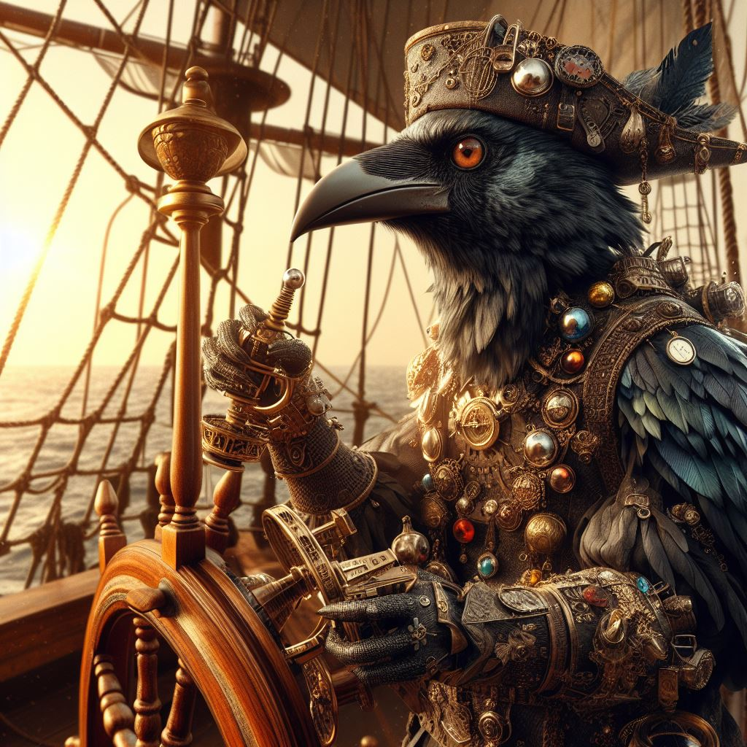
Kenku
Crowen are the scouts and collectors of the Aves races. They have a natural affinity to shiny things and tend to find them irresistible. their kind will adorn themselves from all sorts of baubles, gems and collected sparkly things. These may be extraordinarily valuable, but more often than not are simply gaudy pieces of glass or metal that they have taken a fancy to.
The Crowen are tend to keep company with other members of their kind, being referred to as a murder or crowen. Their tendency to unconsciously pick up things has not earned them favor with most of the kind, even though they are not being malicious or even conscious of doing so. They simply find items in their possession and add them to their adornment or collections. Their primary concern is the preservation of their own life, but will take advantage of any beneficial arrangement.
Crakaw, Crowen Rogue keeping the Nightingale out of the Warbling Sea
Kenku Traits
Ability Score Increase: When determining your character’s ability scores, increase one score by 2 and increase a different score by 1, or increase three different scores by 1.
Age. Kenku generally live up to 120 years and mature around the age of 14
Diet: Kenku are Omnivorous
Alignment. Kenku tend toward the Chaotic alignments
Size. Your size is Medium. You range between 4-5 feet tall and weigh around 100-130 lbs.
Speed. Your base walking speed is 30’ feet.
Reach. Your long arms have a reach of 5’
Flightless. Haunted by an ancient crime that robbed them of their wings, the flightless kenku wander the world as vagabonds and burglars who live at the edge of society
Day walker. You have disadvantage in dark situations and prefer well lit areas.
Keen eyes. You can identify magical items at a mere glance, not the power or abilities but the aspects are particularly shiny to you.
Kenku Recall.Thanks to your supernaturally good memory, you have proficiency in two skills of your choice. Moreover, when you make an ability check using any skill in which you have proficiency, you can give yourself advantage on the check before rolling the d20. You can give yourself advantage in this way a number of times equal to your proficiency bonus, and you regain all expended uses when you finish a long rest.
Mimicry. You can accurately mimic sounds you have heard, including voices. A creature that hears the sounds you make can tell they are imitations only with a successful Wisdom (Insight) check against a DC of 8 + your proficiency bonus + your Charisma modifier.

Slide 3
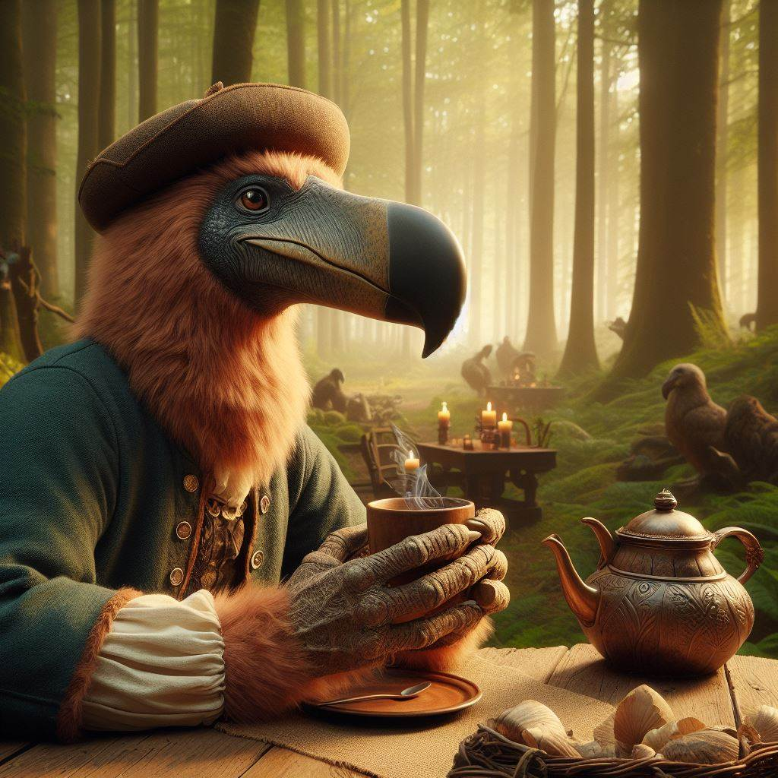
Doden
Slow and steady wins the day in the mind of the Sloven kind. Though they are not weak fighters in combat many of the Sloven rely on the strength of their minds to see them through conflict situations. As crafters they are meticulous and detailed, some of the finest silversmiths and jewelers are among their kind.
They tend to be a peaceful people and would rather spend time learning and studding that wandering around the countryside. It is rare to find one out as an adventurer and can often frustrate the groups they are with because of the pace they set for themselves. Getting a Sloven to get to a point in negotiations or conversation can often be more challenging than most would want to deal with.
Hethle, Sloven Cartographer with his assistant Fetterday
Sloven Traits
Ability Score Increase: Your Wisdom increases by 2, Intelligence increases by 2
Age. Sloven generally live up to 750 years and mature around the age of 50.
Diet: Sloven are herbivorous
Alignment. Sloven tend toward the good alignments, but there have been rare evil Sloven throughout Thera
Size. Your size is Medium. You range between 5-6 feet tall and weigh around 125-200 lbs.
Speed. Your base walking speed is 15’ feet.
Reach. Your long arms have a reach of 10’
Slow Metabolism. You have resistance to poison damage
Darkvision. Accustomed to night life, you have superior vision in dark and dim conditions. You can see in dim light within 60 feet of you as if it were bright light, and in darkness as if it were dim light. You can't discern color in darkness, only shades of gray.
Meditative Mind. You have advantage on all Wisdom or Intelligence saves
Slow as F. Sloven have disadvantage on all Dexterity or Charisma saving throws and proficiency checks
Deliberate Movement. No class abilities, skills or feats can increase your movement rate.

Slide 4
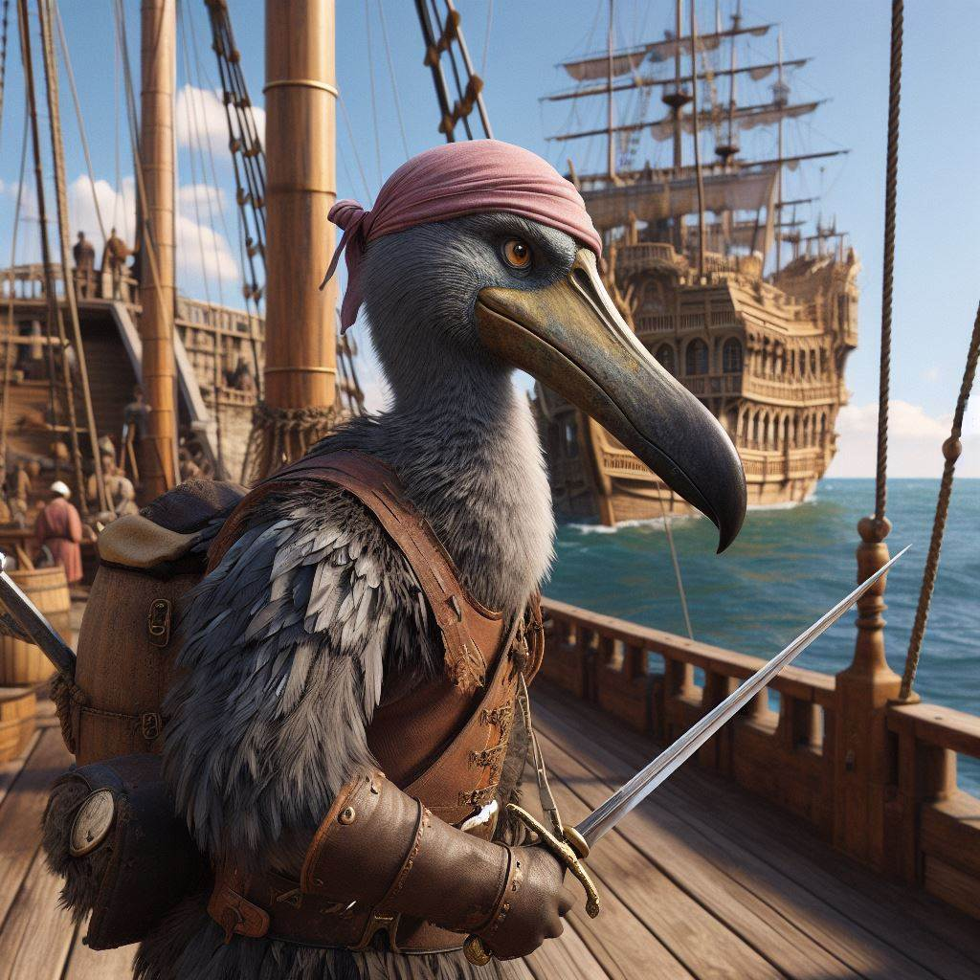
Gullett
Slow and steady wins the day in the mind of the Sloven kind. Though they are not weak fighters in combat many of the Sloven rely on the strength of their minds to see them through conflict situations. As crafters they are meticulous and detailed, some of the finest silversmiths and jewelers are among their kind.
They tend to be a peaceful people and would rather spend time learning and studding that wandering around the countryside. It is rare to find one out as an adventurer and can often frustrate the groups they are with because of the pace they set for themselves. Getting a Sloven to get to a point in negotiations or conversation can often be more challenging than most would want to deal with.
Hethle, Sloven Cartographer with his assistant Fetterday
Sloven Traits
Ability Score Increase: Your Wisdom increases by 2, Intelligence increases by 2
Age. Sloven generally live up to 750 years and mature around the age of 50.
Diet: Sloven are herbivorous
Alignment. Sloven tend toward the good alignments, but there have been rare evil Sloven throughout Thera
Size. Your size is Medium. You range between 5-6 feet tall and weigh around 125-200 lbs.
Speed. Your base walking speed is 15’ feet.
Reach. Your long arms have a reach of 10’
Slow Metabolism. You have resistance to poison damage
Darkvision. Accustomed to night life, you have superior vision in dark and dim conditions. You can see in dim light within 60 feet of you as if it were bright light, and in darkness as if it were dim light. You can't discern color in darkness, only shades of gray.
Meditative Mind. You have advantage on all Wisdom or Intelligence saves
Slow as F. Sloven have disadvantage on all Dexterity or Charisma saving throws and proficiency checks
Deliberate Movement. No class abilities, skills or feats can increase your movement rate.

Slide 5
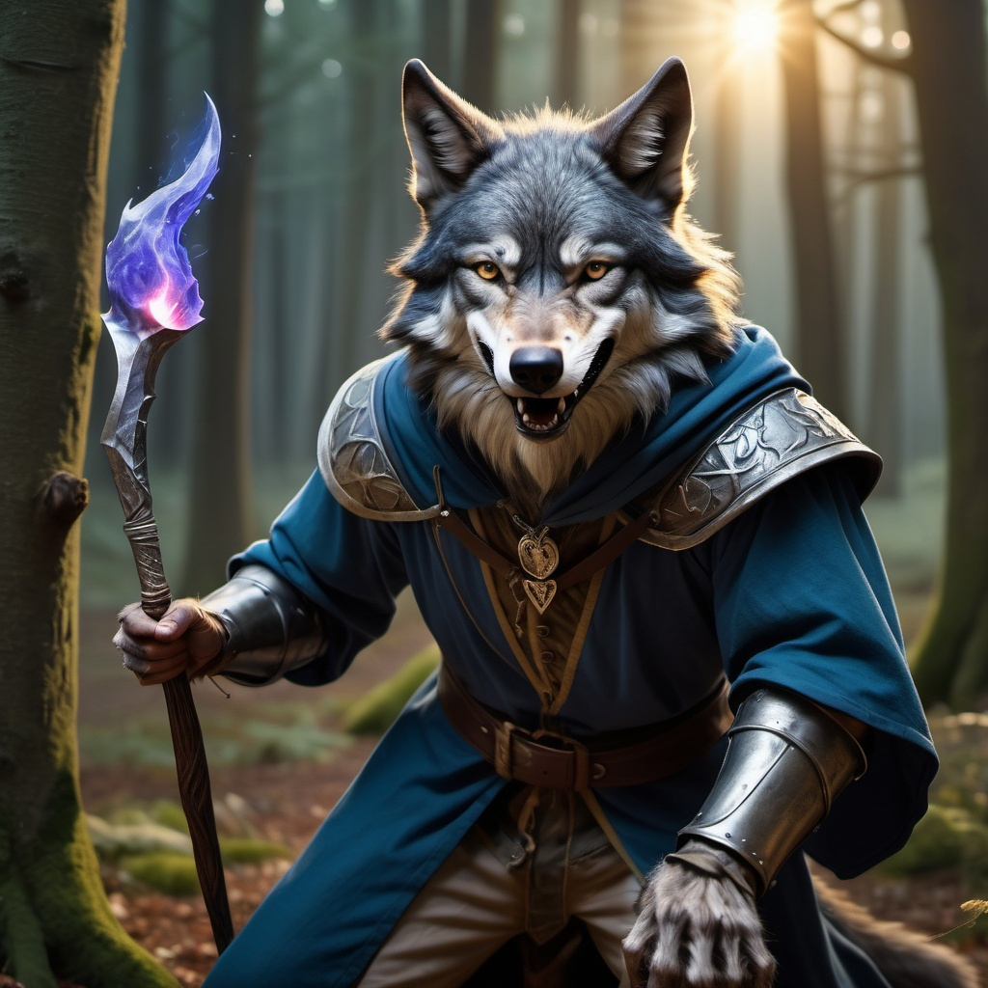
XXX
Slow and steady wins the day in the mind of the Sloven kind. Though they are not weak fighters in combat many of the Sloven rely on the strength of their minds to see them through conflict situations. As crafters they are meticulous and detailed, some of the finest silversmiths and jewelers are among their kind.
They tend to be a peaceful people and would rather spend time learning and studding that wandering around the countryside. It is rare to find one out as an adventurer and can often frustrate the groups they are with because of the pace they set for themselves. Getting a Sloven to get to a point in negotiations or conversation can often be more challenging than most would want to deal with.
Hethle, Sloven Cartographer with his assistant Fetterday
Sloven Traits
Ability Score Increase: Your Wisdom increases by 2, Intelligence increases by 2
Age. Sloven generally live up to 750 years and mature around the age of 50.
Diet: Sloven are herbivorous
Alignment. Sloven tend toward the good alignments, but there have been rare evil Sloven throughout Thera
Size. Your size is Medium. You range between 5-6 feet tall and weigh around 125-200 lbs.
Speed. Your base walking speed is 15’ feet.
Reach. Your long arms have a reach of 10’
Slow Metabolism. You have resistance to poison damage
Darkvision. Accustomed to night life, you have superior vision in dark and dim conditions. You can see in dim light within 60 feet of you as if it were bright light, and in darkness as if it were dim light. You can't discern color in darkness, only shades of gray.
Meditative Mind. You have advantage on all Wisdom or Intelligence saves
Slow as F. Sloven have disadvantage on all Dexterity or Charisma saving throws and proficiency checks
Deliberate Movement. No class abilities, skills or feats can increase your movement rate.

Slide 6
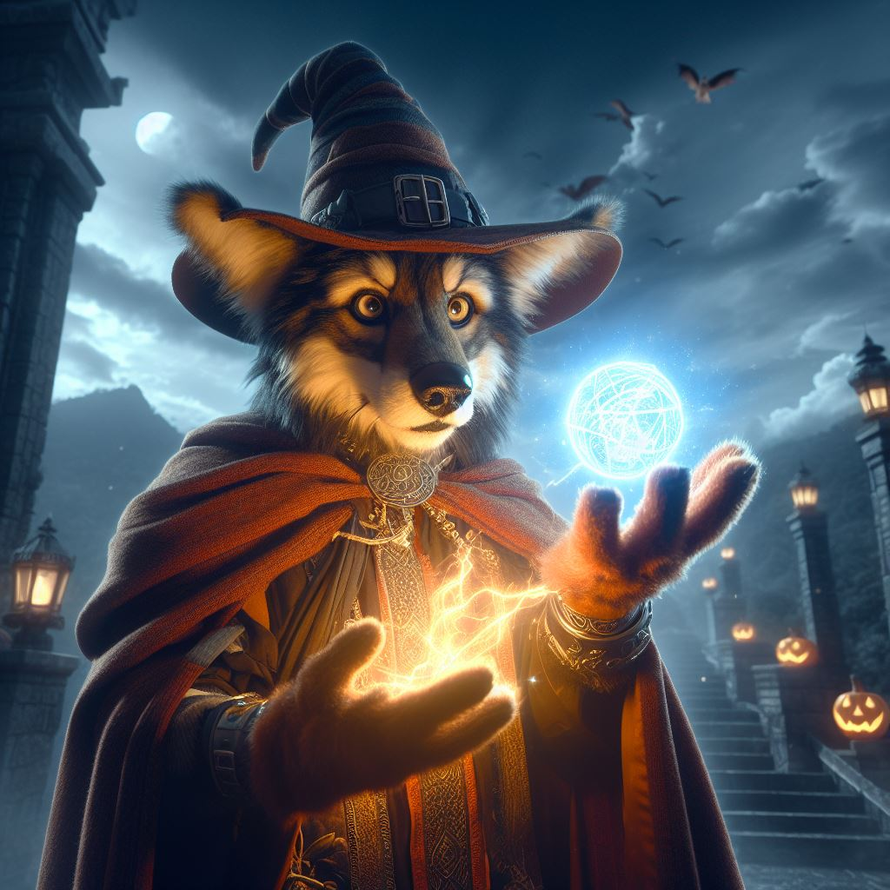
XXX
Slow and steady wins the day in the mind of the Sloven kind. Though they are not weak fighters in combat many of the Sloven rely on the strength of their minds to see them through conflict situations. As crafters they are meticulous and detailed, some of the finest silversmiths and jewelers are among their kind.
They tend to be a peaceful people and would rather spend time learning and studding that wandering around the countryside. It is rare to find one out as an adventurer and can often frustrate the groups they are with because of the pace they set for themselves. Getting a Sloven to get to a point in negotiations or conversation can often be more challenging than most would want to deal with.
Hethle, Sloven Cartographer with his assistant Fetterday
Sloven Traits
Ability Score Increase: Your Wisdom increases by 2, Intelligence increases by 2
Age. Sloven generally live up to 750 years and mature around the age of 50.
Diet: Sloven are herbivorous
Alignment. Sloven tend toward the good alignments, but there have been rare evil Sloven throughout Thera
Size. Your size is Medium. You range between 5-6 feet tall and weigh around 125-200 lbs.
Speed. Your base walking speed is 15’ feet.
Reach. Your long arms have a reach of 10’
Slow Metabolism. You have resistance to poison damage
Darkvision. Accustomed to night life, you have superior vision in dark and dim conditions. You can see in dim light within 60 feet of you as if it were bright light, and in darkness as if it were dim light. You can't discern color in darkness, only shades of gray.
Meditative Mind. You have advantage on all Wisdom or Intelligence saves
Slow as F. Sloven have disadvantage on all Dexterity or Charisma saving throws and proficiency checks
Deliberate Movement. No class abilities, skills or feats can increase your movement rate.

Slide 7
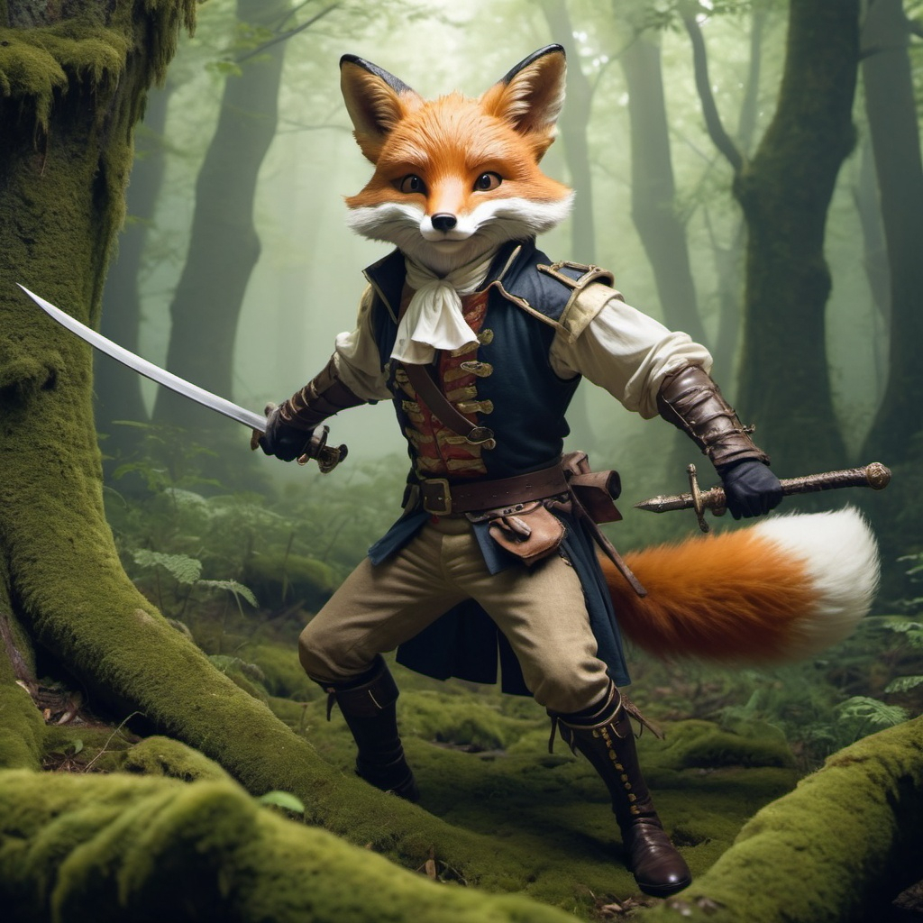
Kitsune
Slow and steady wins the day in the mind of the Sloven kind. Though they are not weak fighters in combat many of the Sloven rely on the strength of their minds to see them through conflict situations. As crafters they are meticulous and detailed, some of the finest silversmiths and jewelers are among their kind.
They tend to be a peaceful people and would rather spend time learning and studding that wandering around the countryside. It is rare to find one out as an adventurer and can often frustrate the groups they are with because of the pace they set for themselves. Getting a Sloven to get to a point in negotiations or conversation can often be more challenging than most would want to deal with.
Hethle, Sloven Cartographer with his assistant Fetterday
Sloven Traits
Ability Score Increase: Your Wisdom increases by 2, Intelligence increases by 2
Age. Sloven generally live up to 750 years and mature around the age of 50.
Diet: Sloven are herbivorous
Alignment. Sloven tend toward the good alignments, but there have been rare evil Sloven throughout Thera
Size. Your size is Medium. You range between 5-6 feet tall and weigh around 125-200 lbs.
Speed. Your base walking speed is 15’ feet.
Reach. Your long arms have a reach of 10’
Slow Metabolism. You have resistance to poison damage
Darkvision. Accustomed to night life, you have superior vision in dark and dim conditions. You can see in dim light within 60 feet of you as if it were bright light, and in darkness as if it were dim light. You can't discern color in darkness, only shades of gray.
Meditative Mind. You have advantage on all Wisdom or Intelligence saves
Slow as F. Sloven have disadvantage on all Dexterity or Charisma saving throws and proficiency checks
Deliberate Movement. No class abilities, skills or feats can increase your movement rate.

Slide 8
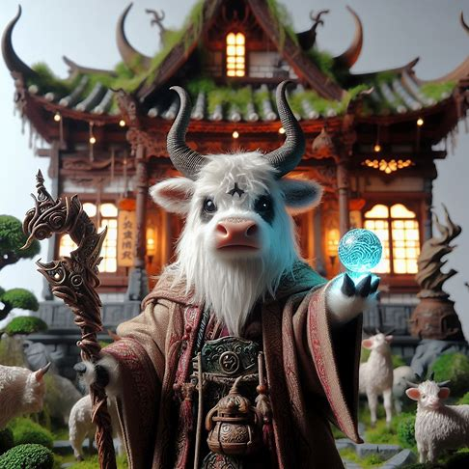
Yakuul
Slow and steady wins the day in the mind of the Sloven kind. Though they are not weak fighters in combat many of the Sloven rely on the strength of their minds to see them through conflict situations. As crafters they are meticulous and detailed, some of the finest silversmiths and jewelers are among their kind.
They tend to be a peaceful people and would rather spend time learning and studding that wandering around the countryside. It is rare to find one out as an adventurer and can often frustrate the groups they are with because of the pace they set for themselves. Getting a Sloven to get to a point in negotiations or conversation can often be more challenging than most would want to deal with.
Hethle, Sloven Cartographer with his assistant Fetterday
Sloven Traits
Ability Score Increase: Your Wisdom increases by 2, Intelligence increases by 2
Age. Sloven generally live up to 750 years and mature around the age of 50.
Diet: Sloven are herbivorous
Alignment. Sloven tend toward the good alignments, but there have been rare evil Sloven throughout Thera
Size. Your size is Medium. You range between 5-6 feet tall and weigh around 125-200 lbs.
Speed. Your base walking speed is 15’ feet.
Reach. Your long arms have a reach of 10’
Slow Metabolism. You have resistance to poison damage
Darkvision. Accustomed to night life, you have superior vision in dark and dim conditions. You can see in dim light within 60 feet of you as if it were bright light, and in darkness as if it were dim light. You can't discern color in darkness, only shades of gray.
Meditative Mind. You have advantage on all Wisdom or Intelligence saves
Slow as F. Sloven have disadvantage on all Dexterity or Charisma saving throws and proficiency checks
Deliberate Movement. No class abilities, skills or feats can increase your movement rate.

Slide 9
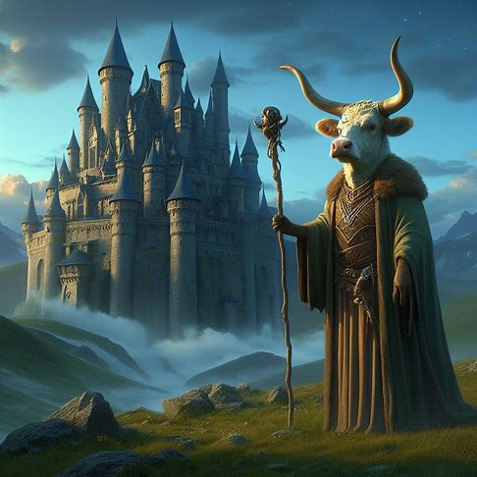
Bovinis
Slow and steady wins the day in the mind of the Sloven kind. Though they are not weak fighters in combat many of the Sloven rely on the strength of their minds to see them through conflict situations. As crafters they are meticulous and detailed, some of the finest silversmiths and jewelers are among their kind.
They tend to be a peaceful people and would rather spend time learning and studding that wandering around the countryside. It is rare to find one out as an adventurer and can often frustrate the groups they are with because of the pace they set for themselves. Getting a Sloven to get to a point in negotiations or conversation can often be more challenging than most would want to deal with.
Hethle, Sloven Cartographer with his assistant Fetterday
Sloven Traits
Ability Score Increase: Your Wisdom increases by 2, Intelligence increases by 2
Age. Sloven generally live up to 750 years and mature around the age of 50.
Diet: Sloven are herbivorous
Alignment. Sloven tend toward the good alignments, but there have been rare evil Sloven throughout Thera
Size. Your size is Medium. You range between 5-6 feet tall and weigh around 125-200 lbs.
Speed. Your base walking speed is 15’ feet.
Reach. Your long arms have a reach of 10’
Slow Metabolism. You have resistance to poison damage
Darkvision. Accustomed to night life, you have superior vision in dark and dim conditions. You can see in dim light within 60 feet of you as if it were bright light, and in darkness as if it were dim light. You can't discern color in darkness, only shades of gray.
Meditative Mind. You have advantage on all Wisdom or Intelligence saves
Slow as F. Sloven have disadvantage on all Dexterity or Charisma saving throws and proficiency checks
Deliberate Movement. No class abilities, skills or feats can increase your movement rate.

Slide 10
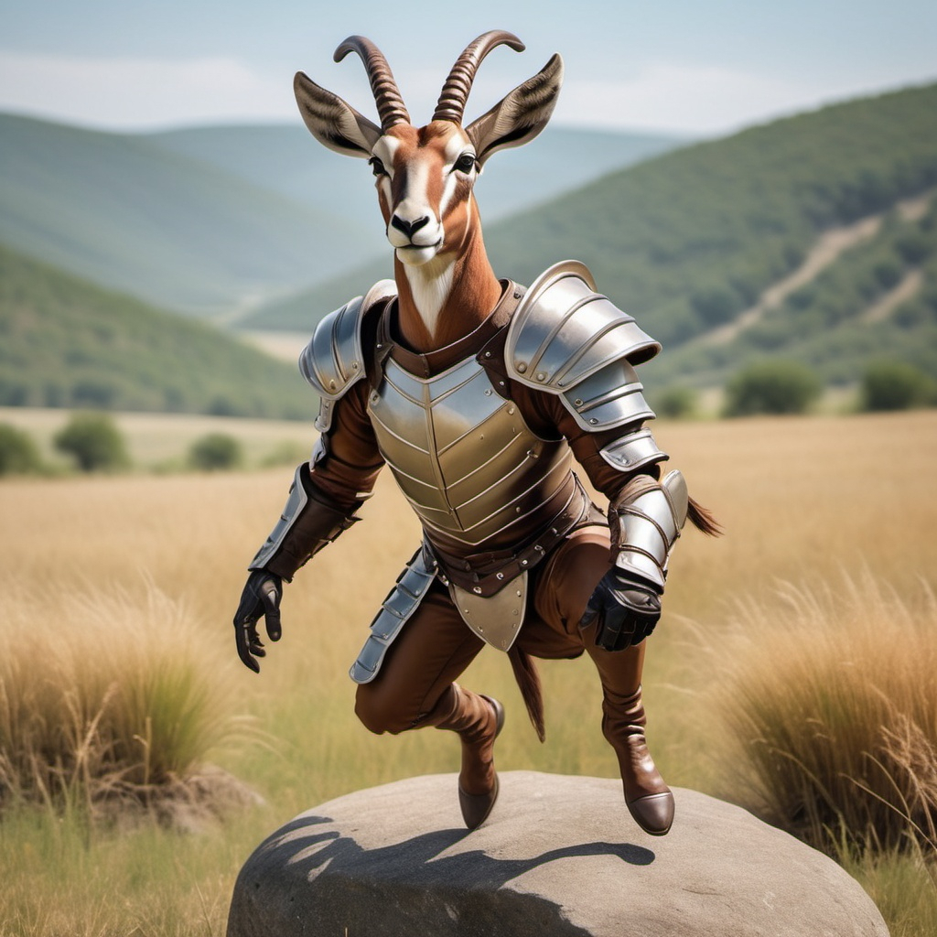
Cervica
Slow and steady wins the day in the mind of the Sloven kind. Though they are not weak fighters in combat many of the Sloven rely on the strength of their minds to see them through conflict situations. As crafters they are meticulous and detailed, some of the finest silversmiths and jewelers are among their kind.
They tend to be a peaceful people and would rather spend time learning and studding that wandering around the countryside. It is rare to find one out as an adventurer and can often frustrate the groups they are with because of the pace they set for themselves. Getting a Sloven to get to a point in negotiations or conversation can often be more challenging than most would want to deal with.
Hethle, Sloven Cartographer with his assistant Fetterday
Sloven Traits
Ability Score Increase: Your Wisdom increases by 2, Intelligence increases by 2
Age. Sloven generally live up to 750 years and mature around the age of 50.
Diet: Sloven are herbivorous
Alignment. Sloven tend toward the good alignments, but there have been rare evil Sloven throughout Thera
Size. Your size is Medium. You range between 5-6 feet tall and weigh around 125-200 lbs.
Speed. Your base walking speed is 15’ feet.
Reach. Your long arms have a reach of 10’
Slow Metabolism. You have resistance to poison damage
Darkvision. Accustomed to night life, you have superior vision in dark and dim conditions. You can see in dim light within 60 feet of you as if it were bright light, and in darkness as if it were dim light. You can't discern color in darkness, only shades of gray.
Meditative Mind. You have advantage on all Wisdom or Intelligence saves
Slow as F. Sloven have disadvantage on all Dexterity or Charisma saving throws and proficiency checks
Deliberate Movement. No class abilities, skills or feats can increase your movement rate.

Slide 11
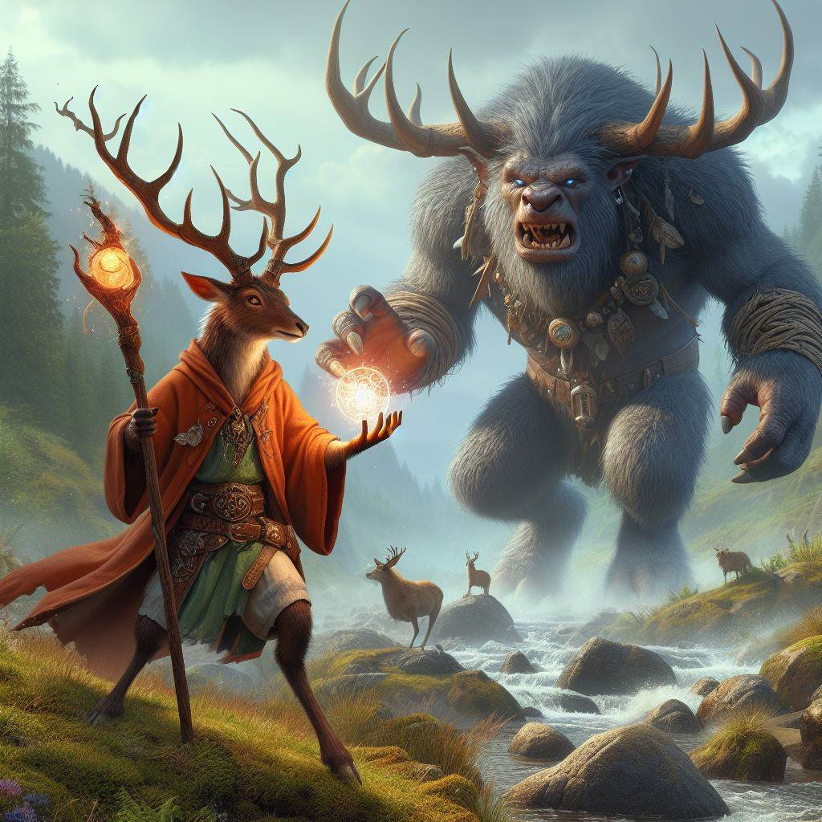
Cervidae
Slow and steady wins the day in the mind of the Sloven kind. Though they are not weak fighters in combat many of the Sloven rely on the strength of their minds to see them through conflict situations. As crafters they are meticulous and detailed, some of the finest silversmiths and jewelers are among their kind.
They tend to be a peaceful people and would rather spend time learning and studding that wandering around the countryside. It is rare to find one out as an adventurer and can often frustrate the groups they are with because of the pace they set for themselves. Getting a Sloven to get to a point in negotiations or conversation can often be more challenging than most would want to deal with.
Hethle, Sloven Cartographer with his assistant Fetterday
Cervidae Traits
Ability Score Increase: Your Dexterity increases by 3
Age. Sloven generally live up to 150 years and mature around the age of 15.
Diet: Sloven are herbivorous
Alignment. Sloven tend toward the good alignments, but there have been rare evil Sloven throughout Thera
Size. Your size is Medium. You range between 5-6 feet tall and weigh around 125-200 lbs.
Speed. Your base walking speed is 15’ feet.
Reach. Your long arms have a reach of 10’
Slow Metabolism. You have resistance to poison damage
Darkvision. Accustomed to night life, you have superior vision in dark and dim conditions. You can see in dim light within 60 feet of you as if it were bright light, and in darkness as if it were dim light. You can't discern color in darkness, only shades of gray.
Meditative Mind. You have advantage on all Wisdom or Intelligence saves
Slow as F. Sloven have disadvantage on all Dexterity or Charisma saving throws and proficiency checks
Deliberate Movement. No class abilities, skills or feats can increase your movement rate.

Slide 12
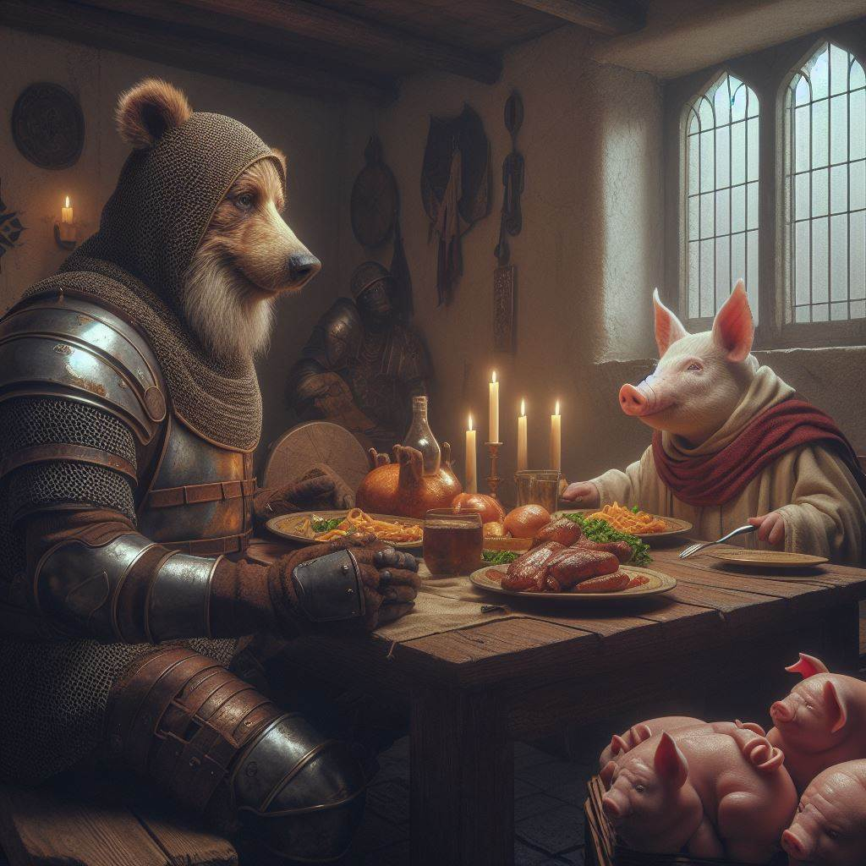
Suidae
Slow and steady wins the day in the mind of the Sloven kind. Though they are not weak fighters in combat many of the Sloven rely on the strength of their minds to see them through conflict situations. As crafters they are meticulous and detailed, some of the finest silversmiths and jewelers are among their kind.
They tend to be a peaceful people and would rather spend time learning and studding that wandering around the countryside. It is rare to find one out as an adventurer and can often frustrate the groups they are with because of the pace they set for themselves. Getting a Sloven to get to a point in negotiations or conversation can often be more challenging than most would want to deal with.
Piglett, the Porcine sharing a meal with his long time friend, Winnie
Sloven Traits
Ability Score Increase: Your Wisdom increases by 2, Intelligence increases by 2
Age. Sloven generally live up to 750 years and mature around the age of 50.
Diet: Sloven are herbivorous
Alignment. Sloven tend toward the good alignments, but there have been rare evil Sloven throughout Thera
Size. Your size is Medium. You range between 5-6 feet tall and weigh around 125-200 lbs.
Speed. Your base walking speed is 15’ feet.
Reach. Your long arms have a reach of 10’
Slow Metabolism. You have resistance to poison damage
Darkvision. Accustomed to night life, you have superior vision in dark and dim conditions. You can see in dim light within 60 feet of you as if it were bright light, and in darkness as if it were dim light. You can't discern color in darkness, only shades of gray.
Meditative Mind. You have advantage on all Wisdom or Intelligence saves
Slow as F. Sloven have disadvantage on all Dexterity or Charisma saving throws and proficiency checks
Deliberate Movement. No class abilities, skills or feats can increase your movement rate.

Slide 13
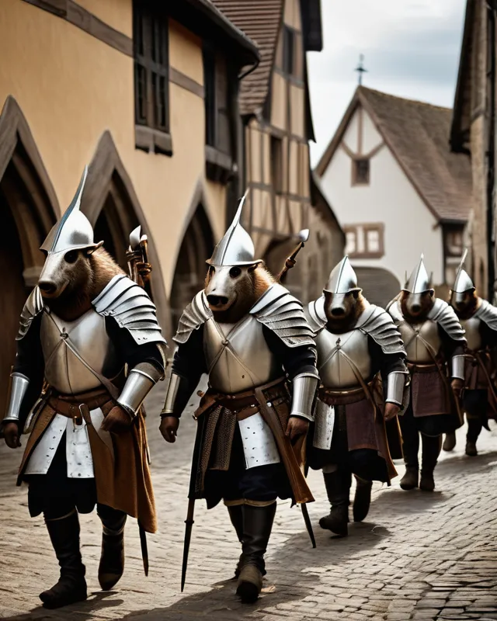
Scrofa
Slow and steady wins the day in the mind of the Sloven kind. Though they are not weak fighters in combat many of the Sloven rely on the strength of their minds to see them through conflict situations. As crafters they are meticulous and detailed, some of the finest silversmiths and jewelers are among their kind.
They tend to be a peaceful people and would rather spend time learning and studding that wandering around the countryside. It is rare to find one out as an adventurer and can often frustrate the groups they are with because of the pace they set for themselves. Getting a Sloven to get to a point in negotiations or conversation can often be more challenging than most would want to deal with.
Piglett, the Porcine sharing a meal with his long time friend, Winnie
Sloven Traits
Ability Score Increase: Your Wisdom increases by 2, Intelligence increases by 2
Age. Sloven generally live up to 750 years and mature around the age of 50.
Diet: Sloven are herbivorous
Alignment. Sloven tend toward the good alignments, but there have been rare evil Sloven throughout Thera
Size. Your size is Medium. You range between 5-6 feet tall and weigh around 125-200 lbs.
Speed. Your base walking speed is 15’ feet.
Reach. Your long arms have a reach of 10’
Slow Metabolism. You have resistance to poison damage
Darkvision. Accustomed to night life, you have superior vision in dark and dim conditions. You can see in dim light within 60 feet of you as if it were bright light, and in darkness as if it were dim light. You can't discern color in darkness, only shades of gray.
Meditative Mind. You have advantage on all Wisdom or Intelligence saves
Slow as F. Sloven have disadvantage on all Dexterity or Charisma saving throws and proficiency checks
Deliberate Movement. No class abilities, skills or feats can increase your movement rate.

Slide 14
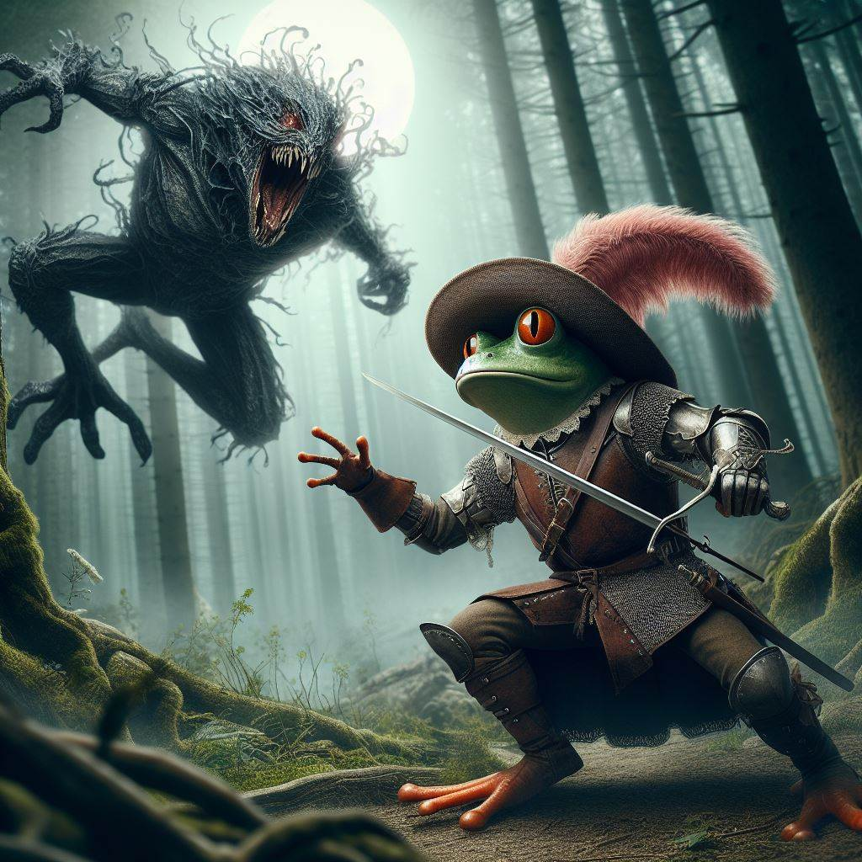
Dendro
xx
Kermitt, Dendrro Swashbuckler defending against a Naroth
Dendro Traits
Ability Score Increase: Your Dexterity increases by 2, Wisdom increases by 1
Age. Dendro generally live up to 50 years and mature around the age of 3.
Diet: Dendro are Insectivourious
Alignment. Dendro have no specific tendancies, but it it not unusual to find more on the chaotic side of life
Size. Your size is Small. You range between 2-4 feet tall and weigh around 20-50 lbs.
Speed. Your base walking speed is 25 feet. Swim 30' Dendro are anphibious and breathe water as well as air
Reach. 5’
Darkvision. Accustomed to night life, you have superior vision in dark and dim conditions. You can see in dim light within 30 feet of you as if it were bright light, and in darkness as if it were dim light. You can't discern color in darkness, only shades of gray.
Meditative Mind. You have advantage on all Wisdom or Intelligence saves
Poison Resistance: You have resistance to poison damage and effects
Poisonous Skin: You constantly secrete a poison from your skin. If a creature touches you, it must make a DC 12 Constitution saving throw or take 1d4 poison damage.
Apply Poison. You may extract poison from yourself applying it to a weapon. The poison retains potency for 1 hour before drying.
Poisoner’s Instinct: Once per long rest, you can create a small vial of poison (similar to a basic poison) from your skin secretions. (DC 12 con save for 1d4 points of damage +proficiency bonus)

Slide 15
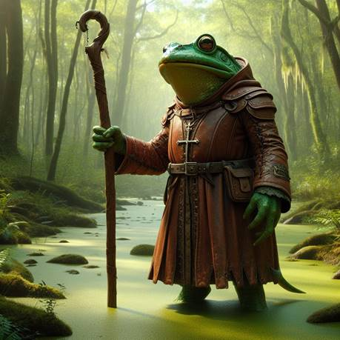
Lithobate
xx
Hethle, Sloven Cartographer with his assistant Fetterday
Lithobate Traits
Ability Score Increase: Your Wisdom increases by 2, Intelligence increases by 2
Age. Sloven generally live up to 750 years and mature around the age of 50.
Diet: Sloven are herbivorous
Alignment. Sloven tend toward the good alignments, but there have been rare evil Sloven throughout Thera
Size. Your size is Medium. You range between 5-6 feet tall and weigh around 125-200 lbs.
Speed. Your base walking speed is 15’ feet.
Reach. Your long arms have a reach of 10’
Slow Metabolism. You have resistance to poison damage
Darkvision. Accustomed to night life, you have superior vision in dark and dim conditions. You can see in dim light within 60 feet of you as if it were bright light, and in darkness as if it were dim light. You can't discern color in darkness, only shades of gray.
Meditative Mind. You have advantage on all Wisdom or Intelligence saves
Slow as F. Sloven have disadvantage on all Dexterity or Charisma saving throws and proficiency checks
Deliberate Movement. No class abilities, skills or feats can increase your movement rate.

Slide 16
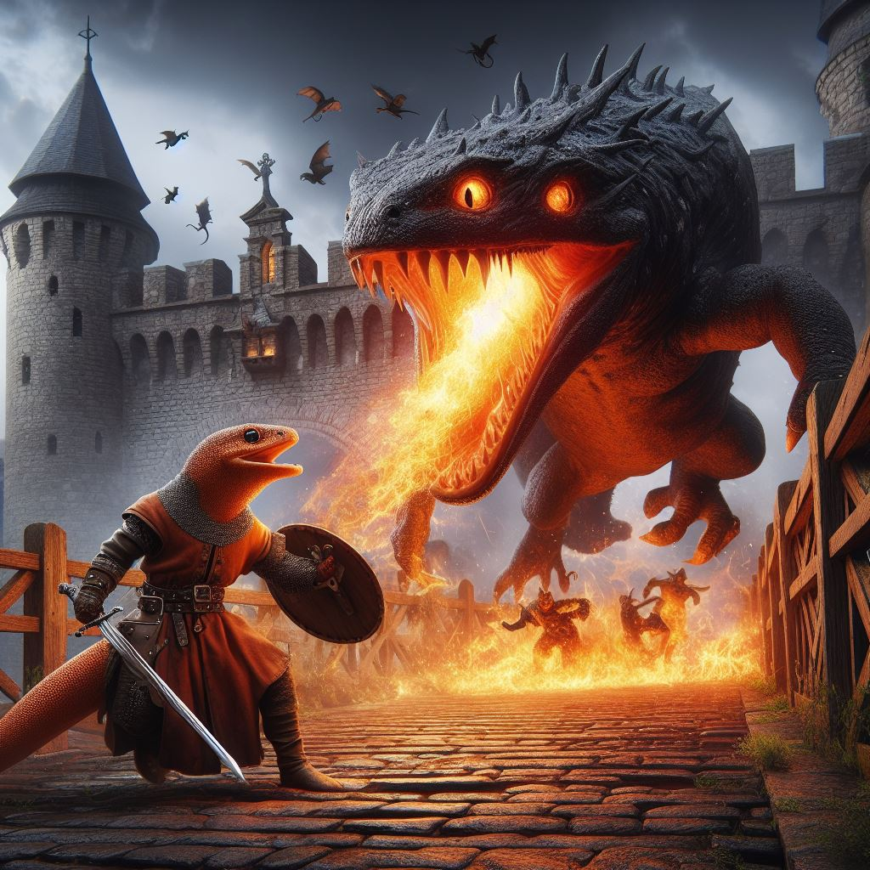
Urodela
Slow and steady wins the day in the mind of the Sloven kind. Though they are not weak fighters in combat many of the Sloven rely on the strength of their minds to see them through conflict situations. As crafters they are meticulous and detailed, some of the finest silversmiths and jewelers are among their kind.
They tend to be a peaceful people and would rather spend time learning and studding that wandering around the countryside. It is rare to find one out as an adventurer and can often frustrate the groups they are with because of the pace they set for themselves. Getting a Sloven to get to a point in negotiations or conversation can often be more challenging than most would want to deal with.
Hethle, Sloven Cartographer with his assistant Fetterday
Sloven Traits
Ability Score Increase: Your Wisdom increases by 2, Intelligence increases by 2
Age. Sloven generally live up to 750 years and mature around the age of 50.
Diet: Sloven are herbivorous
Alignment. Sloven tend toward the good alignments, but there have been rare evil Sloven throughout Thera
Size. Your size is Medium. You range between 5-6 feet tall and weigh around 125-200 lbs.
Speed. Your base walking speed is 15’ feet.
Reach. Your long arms have a reach of 10’
Slimy Skin: You have advantage on saving throws against being grappled or restrained.
Darkvision. Accustomed to night life, you have superior vision in dark and dim conditions. You can see in dim light within 60 feet of you as if it were bright light, and in darkness as if it were dim light. You can't discern color in darkness, only shades of gray.

Slide 17
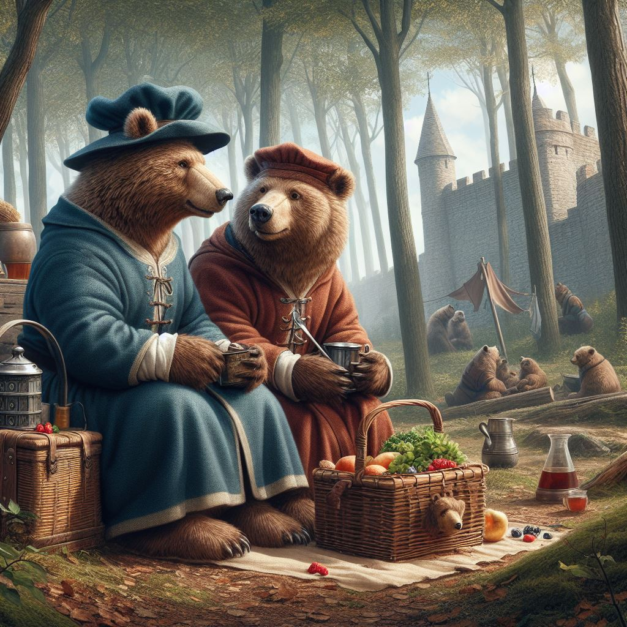
Ursidae
Slow and steady wins the day in the mind of the Sloven kind. Though they are not weak fighters in combat many of the Sloven rely on the strength of their minds to see them through conflict situations. As crafters they are meticulous and detailed, some of the finest silversmiths and jewelers are among their kind.
They tend to be a peaceful people and would rather spend time learning and studding that wandering around the countryside. It is rare to find one out as an adventurer and can often frustrate the groups they are with because of the pace they set for themselves. Getting a Sloven to get to a point in negotiations or conversation can often be more challenging than most would want to deal with.
Yogi and BooBoo, Barex take a break from their shop to have an afternoon picnic
Sloven Traits
Ability Score Increase: Your Wisdom increases by 2, Intelligence increases by 2
Age. Sloven generally live up to 750 years and mature around the age of 50.
Diet: Sloven are herbivorous
Alignment. Sloven tend toward the good alignments, but there have been rare evil Sloven throughout Thera
Size. Your size is Medium. You range between 5-6 feet tall and weigh around 125-200 lbs.
Speed. Your base walking speed is 15’ feet.
Reach. Your long arms have a reach of 10’
Slow Metabolism. You have resistance to poison damage
Darkvision. Accustomed to night life, you have superior vision in dark and dim conditions. You can see in dim light within 60 feet of you as if it were bright light, and in darkness as if it were dim light. You can't discern color in darkness, only shades of gray.
Meditative Mind. You have advantage on all Wisdom or Intelligence saves
Slow as F. Sloven have disadvantage on all Dexterity or Charisma saving throws and proficiency checks
Deliberate Movement. No class abilities, skills or feats can increase your movement rate.

Slide 18
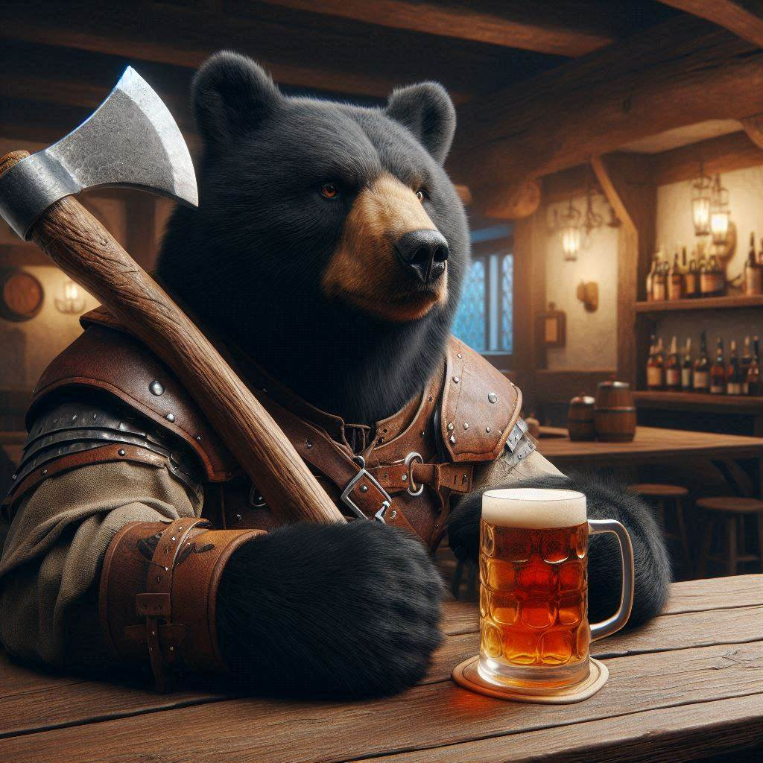
Ursus
Slow and steady wins the day in the mind of the Sloven kind. Though they are not weak fighters in combat many of the Sloven rely on the strength of their minds to see them through conflict situations. As crafters they are meticulous and detailed, some of the finest silversmiths and jewelers are among their kind.
They tend to be a peaceful people and would rather spend time learning and studding that wandering around the countryside. It is rare to find one out as an adventurer and can often frustrate the groups they are with because of the pace they set for themselves. Getting a Sloven to get to a point in negotiations or conversation can often be more challenging than most would want to deal with.
Hethle, Sloven Cartographer with his assistant Fetterday
Sloven Traits
Ability Score Increase: Your Wisdom increases by 2, Intelligence increases by 2
Age. Sloven generally live up to 750 years and mature around the age of 50.
Diet: Sloven are herbivorous
Alignment. Sloven tend toward the good alignments, but there have been rare evil Sloven throughout Thera
Size. Your size is Medium. You range between 5-6 feet tall and weigh around 125-200 lbs.
Speed. Your base walking speed is 15’ feet.
Reach. Your long arms have a reach of 10’
Slow Metabolism. You have resistance to poison damage
Darkvision. Accustomed to night life, you have superior vision in dark and dim conditions. You can see in dim light within 60 feet of you as if it were bright light, and in darkness as if it were dim light. You can't discern color in darkness, only shades of gray.
Meditative Mind. You have advantage on all Wisdom or Intelligence saves
Slow as F. Sloven have disadvantage on all Dexterity or Charisma saving throws and proficiency checks
Deliberate Movement. No class abilities, skills or feats can increase your movement rate.

Slide 19
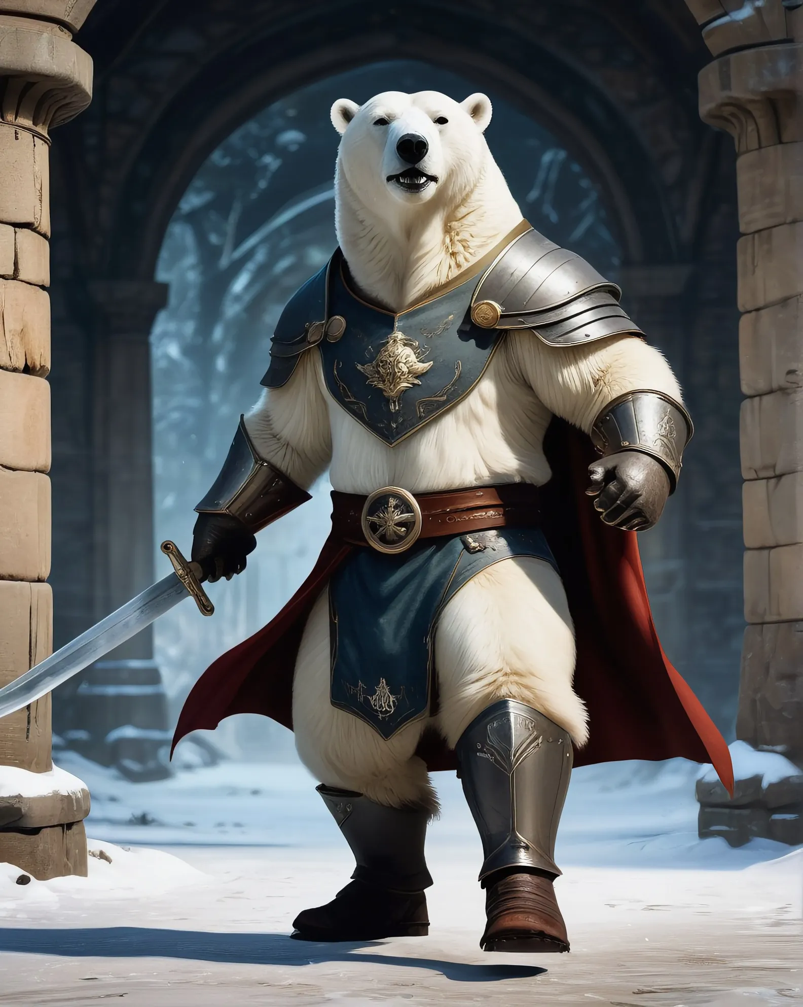
Martimus
Slow and steady wins the day in the mind of the Sloven kind. Though they are not weak fighters in combat many of the Sloven rely on the strength of their minds to see them through conflict situations. As crafters they are meticulous and detailed, some of the finest silversmiths and jewelers are among their kind.
They tend to be a peaceful people and would rather spend time learning and studding that wandering around the countryside. It is rare to find one out as an adventurer and can often frustrate the groups they are with because of the pace they set for themselves. Getting a Sloven to get to a point in negotiations or conversation can often be more challenging than most would want to deal with.
Hethle, Sloven Cartographer with his assistant Fetterday
Sloven Traits
Ability Score Increase: Your Wisdom increases by 2, Intelligence increases by 2
Age. Sloven generally live up to 750 years and mature around the age of 50.
Diet: Sloven are herbivorous
Alignment. Sloven tend toward the good alignments, but there have been rare evil Sloven throughout Thera
Size. Your size is Medium. You range between 5-6 feet tall and weigh around 125-200 lbs.
Speed. Your base walking speed is 15’ feet.
Reach. Your long arms have a reach of 10’
Slow Metabolism. You have resistance to poison damage
Darkvision. Accustomed to night life, you have superior vision in dark and dim conditions. You can see in dim light within 60 feet of you as if it were bright light, and in darkness as if it were dim light. You can't discern color in darkness, only shades of gray.
Meditative Mind. You have advantage on all Wisdom or Intelligence saves
Slow as F. Sloven have disadvantage on all Dexterity or Charisma saving throws and proficiency checks
Deliberate Movement. No class abilities, skills or feats can increase your movement rate.

Slide 20
Tigris
Slow and steady wins the day in the mind of the Sloven kind. Though they are not weak fighters in combat many of the Sloven rely on the strength of their minds to see them through conflict situations. As crafters they are meticulous and detailed, some of the finest silversmiths and jewelers are among their kind.
They tend to be a peaceful people and would rather spend time learning and studding that wandering around the countryside. It is rare to find one out as an adventurer and can often frustrate the groups they are with because of the pace they set for themselves. Getting a Sloven to get to a point in negotiations or conversation can often be more challenging than most would want to deal with.
Tony, Sloven Cartographer with his assistant Fetterday
Sloven Traits
Ability Score Increase: Your Wisdom increases by 2, Intelligence increases by 2
Age. Sloven generally live up to 750 years and mature around the age of 50.
Diet: Sloven are herbivorous
Alignment. Sloven tend toward the good alignments, but there have been rare evil Sloven throughout Thera
Size. Your size is Medium. You range between 5-6 feet tall and weigh around 125-200 lbs.
Speed. Your base walking speed is 15’ feet.
Reach. Your long arms have a reach of 10’
Slow Metabolism. You have resistance to poison damage
Darkvision. Accustomed to night life, you have superior vision in dark and dim conditions. You can see in dim light within 60 feet of you as if it were bright light, and in darkness as if it were dim light. You can't discern color in darkness, only shades of gray.
Meditative Mind. You have advantage on all Wisdom or Intelligence saves
Slow as F. Sloven have disadvantage on all Dexterity or Charisma saving throws and proficiency checks
Deliberate Movement. No class abilities, skills or feats can increase your movement rate.

Slide 21
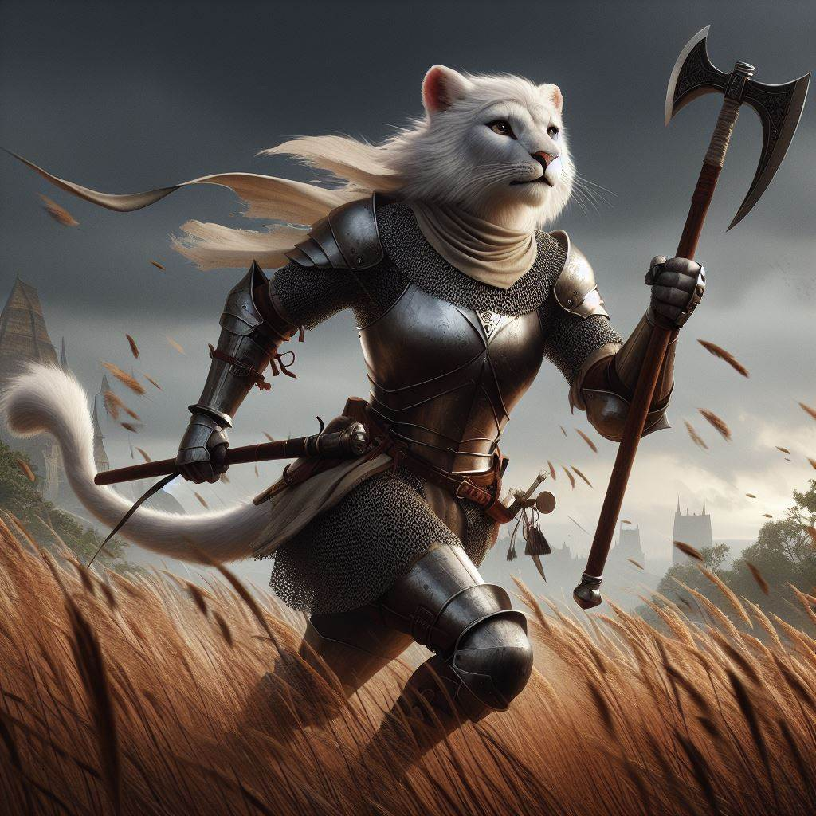
Leonin
Slow and steady wins the day in the mind of the Sloven kind. Though they are not weak fighters in combat many of the Sloven rely on the strength of their minds to see them through conflict situations. As crafters they are meticulous and detailed, some of the finest silversmiths and jewelers are among their kind.
They tend to be a peaceful people and would rather spend time learning and studding that wandering around the countryside. It is rare to find one out as an adventurer and can often frustrate the groups they are with because of the pace they set for themselves. Getting a Sloven to get to a point in negotiations or conversation can often be more challenging than most would want to deal with.
Hethle, Sloven Cartographer with his assistant Fetterday
Sloven Traits
Ability Score Increase: Your Wisdom increases by 2, Intelligence increases by 2
Age. Sloven generally live up to 750 years and mature around the age of 50.
Diet: Sloven are herbivorous
Alignment. Sloven tend toward the good alignments, but there have been rare evil Sloven throughout Thera
Size. Your size is Medium. You range between 5-6 feet tall and weigh around 125-200 lbs.
Speed. Your base walking speed is 15’ feet.
Reach. Your long arms have a reach of 10’
Slow Metabolism. You have resistance to poison damage
Darkvision. Accustomed to night life, you have superior vision in dark and dim conditions. You can see in dim light within 60 feet of you as if it were bright light, and in darkness as if it were dim light. You can't discern color in darkness, only shades of gray.
Meditative Mind. You have advantage on all Wisdom or Intelligence saves
Slow as F. Sloven have disadvantage on all Dexterity or Charisma saving throws and proficiency checks
Deliberate Movement. No class abilities, skills or feats can increase your movement rate.

Slide 22
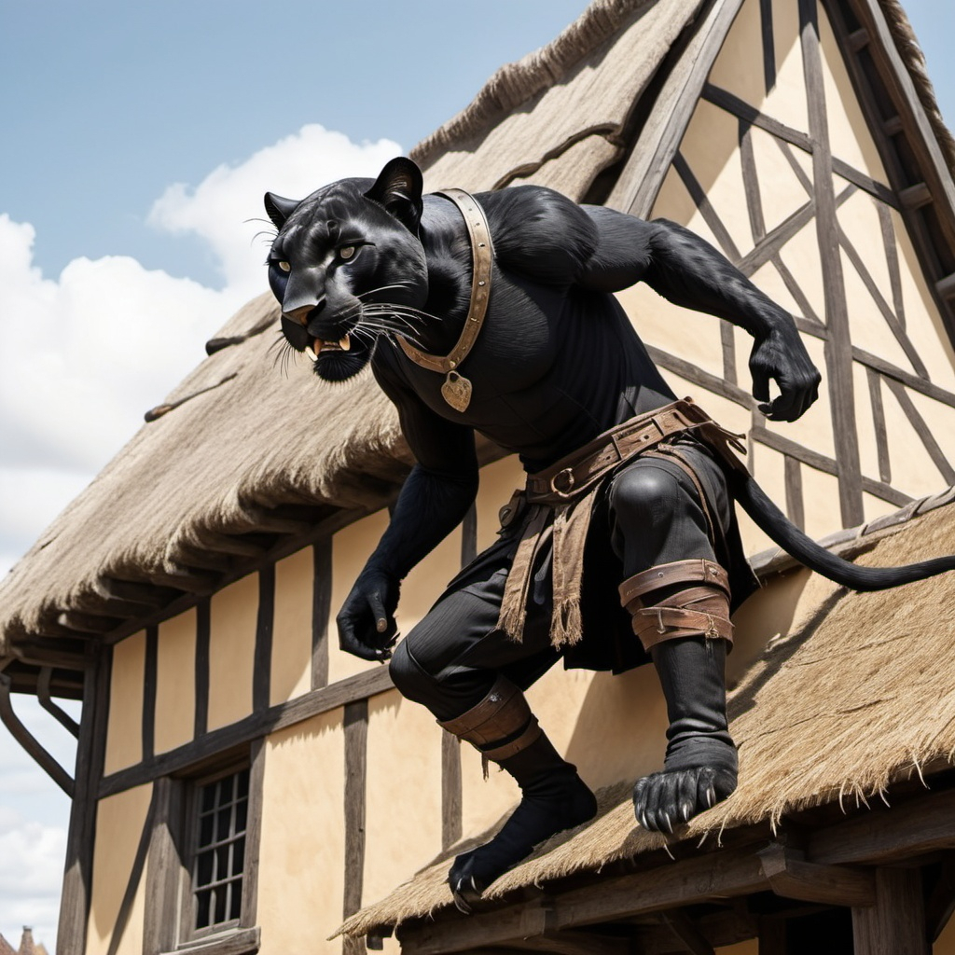
Pardus
Slow and steady wins the day in the mind of the Sloven kind. Though they are not weak fighters in combat many of the Sloven rely on the strength of their minds to see them through conflict situations. As crafters they are meticulous and detailed, some of the finest silversmiths and jewelers are among their kind.
They tend to be a peaceful people and would rather spend time learning and studding that wandering around the countryside. It is rare to find one out as an adventurer and can often frustrate the groups they are with because of the pace they set for themselves. Getting a Sloven to get to a point in negotiations or conversation can often be more challenging than most would want to deal with.
Hethle, Sloven Cartographer with his assistant Fetterday
Sloven Traits
Ability Score Increase: Your Wisdom increases by 2, Intelligence increases by 2
Age. Sloven generally live up to 750 years and mature around the age of 50.
Diet: Sloven are herbivorous
Alignment. Sloven tend toward the good alignments, but there have been rare evil Sloven throughout Thera
Size. Your size is Medium. You range between 5-6 feet tall and weigh around 125-200 lbs.
Speed. Your base walking speed is 15’ feet.
Reach. Your long arms have a reach of 10’
Slow Metabolism. You have resistance to poison damage
Darkvision. Accustomed to night life, you have superior vision in dark and dim conditions. You can see in dim light within 60 feet of you as if it were bright light, and in darkness as if it were dim light. You can't discern color in darkness, only shades of gray.
Meditative Mind. You have advantage on all Wisdom or Intelligence saves
Slow as F. Sloven have disadvantage on all Dexterity or Charisma saving throws and proficiency checks
Deliberate Movement. No class abilities, skills or feats can increase your movement rate.

Slide 23
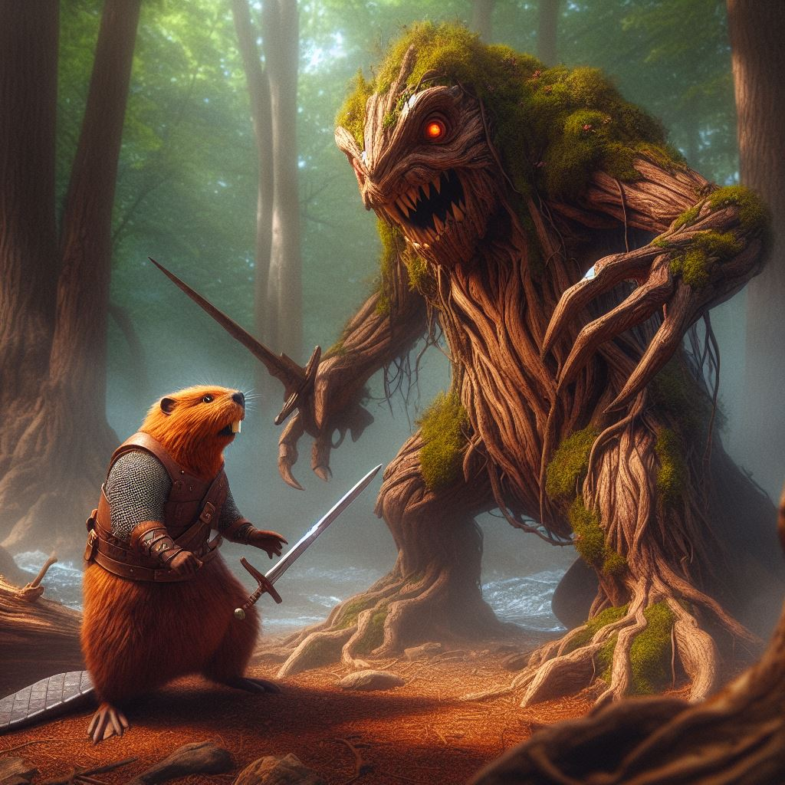
Castor
Slow and steady wins the day in the mind of the Sloven kind. Though they are not weak fighters in combat many of the Sloven rely on the strength of their minds to see them through conflict situations. As crafters they are meticulous and detailed, some of the finest silversmiths and jewelers are among their kind.
They tend to be a peaceful people and would rather spend time learning and studding that wandering around the countryside. It is rare to find one out as an adventurer and can often frustrate the groups they are with because of the pace they set for themselves. Getting a Sloven to get to a point in negotiations or conversation can often be more challenging than most would want to deal with.
Buckey, Sloven Cartographer with his assistant Fetterday
Sloven Traits
Ability Score Increase: Your Wisdom increases by 2, Intelligence increases by 2
Age. Sloven generally live up to 750 years and mature around the age of 50.
Diet: Sloven are herbivorous
Alignment. Sloven tend toward the good alignments, but there have been rare evil Sloven throughout Thera
Size. Your size is Medium. You range between 5-6 feet tall and weigh around 125-200 lbs.
Speed. Your base walking speed is 15’ feet.
Reach. Your long arms have a reach of 10’
Slow Metabolism. You have resistance to poison damage
Darkvision. Accustomed to night life, you have superior vision in dark and dim conditions. You can see in dim light within 60 feet of you as if it were bright light, and in darkness as if it were dim light. You can't discern color in darkness, only shades of gray.
Meditative Mind. You have advantage on all Wisdom or Intelligence saves
Slow as F. Sloven have disadvantage on all Dexterity or Charisma saving throws and proficiency checks
Deliberate Movement. No class abilities, skills or feats can increase your movement rate.

Slide 24
Roxellana
Slow and steady wins the day in the mind of the Sloven kind. Though they are not weak fighters in combat many of the Sloven rely on the strength of their minds to see them through conflict situations. As crafters they are meticulous and detailed, some of the finest silversmiths and jewelers are among their kind.
They tend to be a peaceful people and would rather spend time learning and studding that wandering around the countryside. It is rare to find one out as an adventurer and can often frustrate the groups they are with because of the pace they set for themselves. Getting a Sloven to get to a point in negotiations or conversation can often be more challenging than most would want to deal with.
Hethle, Sloven Cartographer with his assistant Fetterday
Sloven Traits
Ability Score Increase: Your Wisdom increases by 2, Intelligence increases by 2
Age. Sloven generally live up to 750 years and mature around the age of 50.
Diet: Sloven are herbivorous
Alignment. Sloven tend toward the good alignments, but there have been rare evil Sloven throughout Thera
Size. Your size is Medium. You range between 5-6 feet tall and weigh around 125-200 lbs.
Speed. Your base walking speed is 15’ feet.
Reach. Your long arms have a reach of 10’
Slow Metabolism. You have resistance to poison damage
Darkvision. Accustomed to night life, you have superior vision in dark and dim conditions. You can see in dim light within 60 feet of you as if it were bright light, and in darkness as if it were dim light. You can't discern color in darkness, only shades of gray.
Meditative Mind. You have advantage on all Wisdom or Intelligence saves
Slow as F. Sloven have disadvantage on all Dexterity or Charisma saving throws and proficiency checks
Deliberate Movement. No class abilities, skills or feats can increase your movement rate.

Slide 25
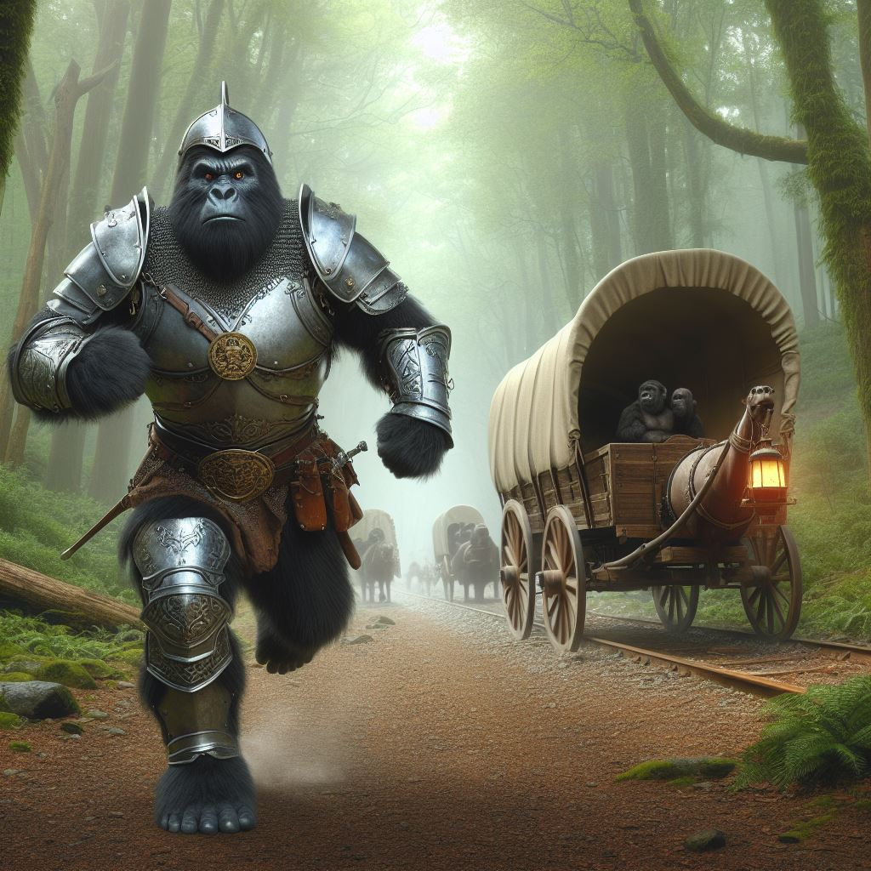
Troglod
Slow and steady wins the day in the mind of the Sloven kind. Though they are not weak fighters in combat many of the Sloven rely on the strength of their minds to see them through conflict situations. As crafters they are meticulous and detailed, some of the finest silversmiths and jewelers are among their kind.
They tend to be a peaceful people and would rather spend time learning and studding that wandering around the countryside. It is rare to find one out as an adventurer and can often frustrate the groups they are with because of the pace they set for themselves. Getting a Sloven to get to a point in negotiations or conversation can often be more challenging than most would want to deal with.
Hethle, Sloven Cartographer with his assistant Fetterday
Sloven Traits
Ability Score Increase: Your Wisdom increases by 2, Intelligence increases by 2
Age. Sloven generally live up to 750 years and mature around the age of 50.
Diet: Sloven are herbivorous
Alignment. Sloven tend toward the good alignments, but there have been rare evil Sloven throughout Thera
Size. Your size is Medium. You range between 5-6 feet tall and weigh around 125-200 lbs.
Speed. Your base walking speed is 15’ feet.
Reach. Your long arms have a reach of 10’
Slow Metabolism. You have resistance to poison damage
Darkvision. Accustomed to night life, you have superior vision in dark and dim conditions. You can see in dim light within 60 feet of you as if it were bright light, and in darkness as if it were dim light. You can't discern color in darkness, only shades of gray.
Meditative Mind. You have advantage on all Wisdom or Intelligence saves
Slow as F. Sloven have disadvantage on all Dexterity or Charisma saving throws and proficiency checks
Deliberate Movement. No class abilities, skills or feats can increase your movement rate.

Slide 26
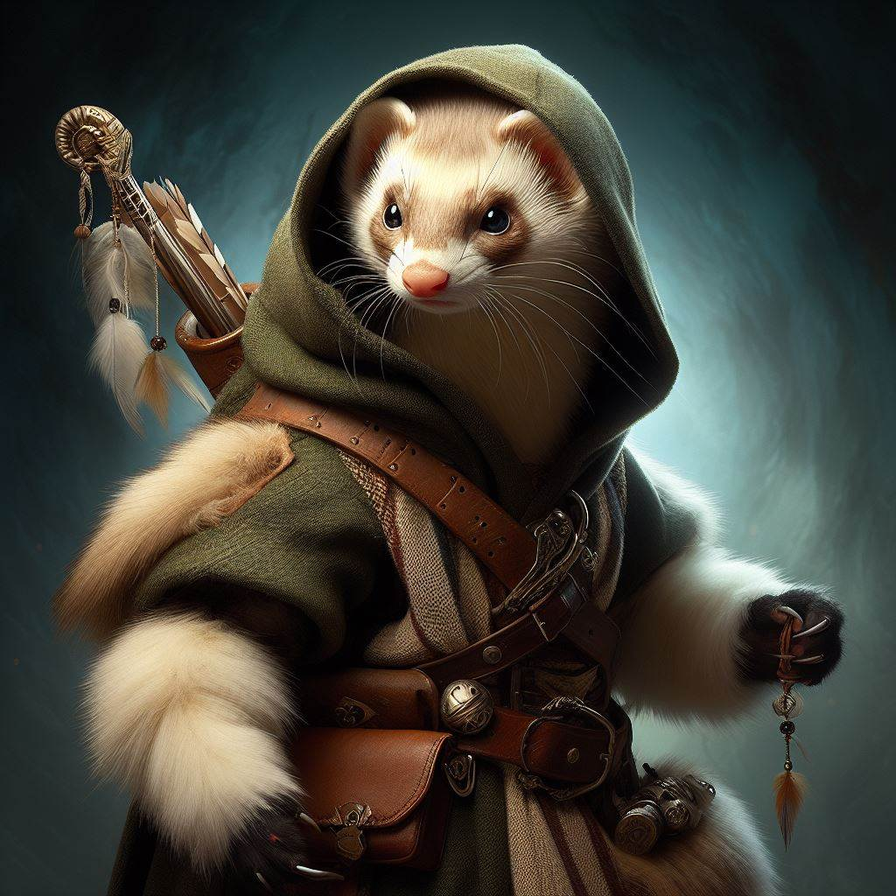
Mustela
Slow and steady wins the day in the mind of the Sloven kind. Though they are not weak fighters in combat many of the Sloven rely on the strength of their minds to see them through conflict situations. As crafters they are meticulous and detailed, some of the finest silversmiths and jewelers are among their kind.
They tend to be a peaceful people and would rather spend time learning and studding that wandering around the countryside. It is rare to find one out as an adventurer and can often frustrate the groups they are with because of the pace they set for themselves. Getting a Sloven to get to a point in negotiations or conversation can often be more challenging than most would want to deal with.
Hethle, Sloven Cartographer with his assistant Fetterday
Sloven Traits
Ability Score Increase: Your Wisdom increases by 2, Intelligence increases by 2
Age. Sloven generally live up to 750 years and mature around the age of 50.
Diet: Sloven are herbivorous
Alignment. Sloven tend toward the good alignments, but there have been rare evil Sloven throughout Thera
Size. Your size is Medium. You range between 5-6 feet tall and weigh around 125-200 lbs.
Speed. Your base walking speed is 15’ feet.
Reach. Your long arms have a reach of 10’
Slow Metabolism. You have resistance to poison damage
Darkvision. Accustomed to night life, you have superior vision in dark and dim conditions. You can see in dim light within 60 feet of you as if it were bright light, and in darkness as if it were dim light. You can't discern color in darkness, only shades of gray.
Meditative Mind. You have advantage on all Wisdom or Intelligence saves
Slow as F. Sloven have disadvantage on all Dexterity or Charisma saving throws and proficiency checks
Deliberate Movement. No class abilities, skills or feats can increase your movement rate.

Slide 27
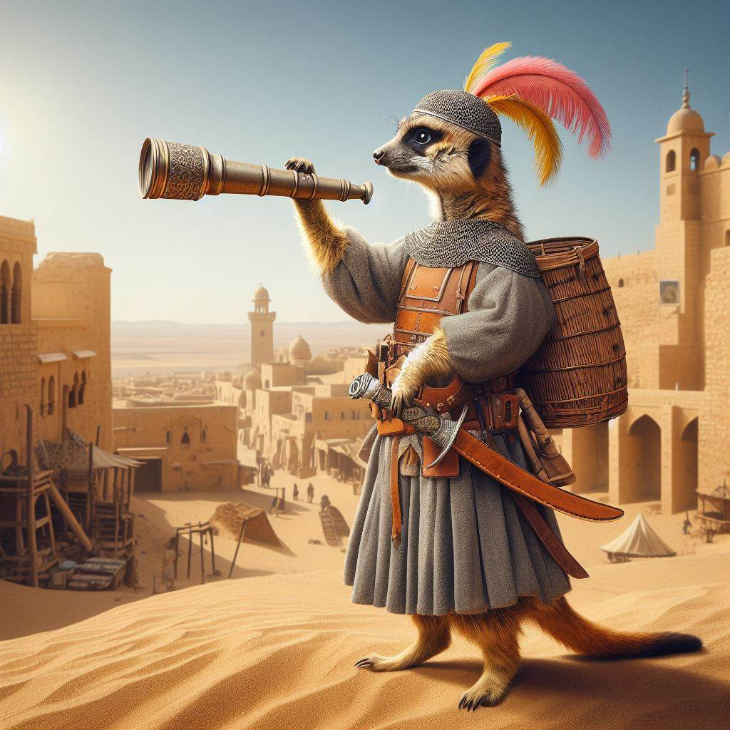
Suricata
Slow and steady wins the day in the mind of the Sloven kind. Though they are not weak fighters in combat many of the Sloven rely on the strength of their minds to see them through conflict situations. As crafters they are meticulous and detailed, some of the finest silversmiths and jewelers are among their kind.
They tend to be a peaceful people and would rather spend time learning and studding that wandering around the countryside. It is rare to find one out as an adventurer and can often frustrate the groups they are with because of the pace they set for themselves. Getting a Sloven to get to a point in negotiations or conversation can often be more challenging than most would want to deal with.
Hethle, Sloven Cartographer with his assistant Fetterday
Sloven Traits
Ability Score Increase: Your Wisdom increases by 2, Intelligence increases by 2
Age. Sloven generally live up to 750 years and mature around the age of 50.
Diet: Sloven are herbivorous
Alignment. Sloven tend toward the good alignments, but there have been rare evil Sloven throughout Thera
Size. Your size is Medium. You range between 5-6 feet tall and weigh around 125-200 lbs.
Speed. Your base walking speed is 15’ feet.
Reach. Your long arms have a reach of 10’
Slow Metabolism. You have resistance to poison damage
Darkvision. Accustomed to night life, you have superior vision in dark and dim conditions. You can see in dim light within 60 feet of you as if it were bright light, and in darkness as if it were dim light. You can't discern color in darkness, only shades of gray.
Meditative Mind. You have advantage on all Wisdom or Intelligence saves
Slow as F. Sloven have disadvantage on all Dexterity or Charisma saving throws and proficiency checks
Deliberate Movement. No class abilities, skills or feats can increase your movement rate.

Slide 28
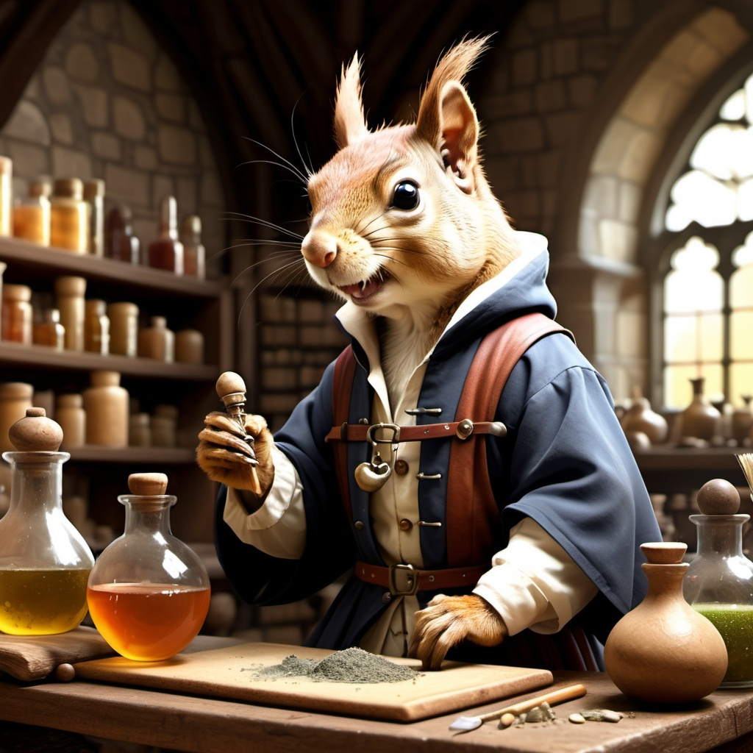
Scuiridae
Slow and steady wins the day in the mind of the Sloven kind. Though they are not weak fighters in combat many of the Sloven rely on the strength of their minds to see them through conflict situations. As crafters they are meticulous and detailed, some of the finest silversmiths and jewelers are among their kind.
They tend to be a peaceful people and would rather spend time learning and studding that wandering around the countryside. It is rare to find one out as an adventurer and can often frustrate the groups they are with because of the pace they set for themselves. Getting a Sloven to get to a point in negotiations or conversation can often be more challenging than most would want to deal with.
Hethle, Sloven Cartographer with his assistant Fetterday
Sloven Traits
Ability Score Increase: Your Wisdom increases by 2, Intelligence increases by 2
Age. Sloven generally live up to 750 years and mature around the age of 50.
Diet: Sloven are herbivorous
Alignment. Sloven tend toward the good alignments, but there have been rare evil Sloven throughout Thera
Size. Your size is Medium. You range between 5-6 feet tall and weigh around 125-200 lbs.
Speed. Your base walking speed is 15’ feet.
Reach. Your long arms have a reach of 10’
Slow Metabolism. You have resistance to poison damage
Darkvision. Accustomed to night life, you have superior vision in dark and dim conditions. You can see in dim light within 60 feet of you as if it were bright light, and in darkness as if it were dim light. You can't discern color in darkness, only shades of gray.
Meditative Mind. You have advantage on all Wisdom or Intelligence saves
Slow as F. Sloven have disadvantage on all Dexterity or Charisma saving throws and proficiency checks
Deliberate Movement. No class abilities, skills or feats can increase your movement rate.

Slide 29
Lupus
Slow and steady wins the day in the mind of the Sloven kind. Though they are not weak fighters in combat many of the Sloven rely on the strength of their minds to see them through conflict situations. As crafters they are meticulous and detailed, some of the finest silversmiths and jewelers are among their kind.
They tend to be a peaceful people and would rather spend time learning and studding that wandering around the countryside. It is rare to find one out as an adventurer and can often frustrate the groups they are with because of the pace they set for themselves. Getting a Sloven to get to a point in negotiations or conversation can often be more challenging than most would want to deal with.
Hethle, Sloven Cartographer with his assistant Fetterday
Sloven Traits
Ability Score Increase: Your Wisdom increases by 2, Intelligence increases by 2
Age. Sloven generally live up to 750 years and mature around the age of 50.
Diet: Sloven are herbivorous
Alignment. Sloven tend toward the good alignments, but there have been rare evil Sloven throughout Thera
Size. Your size is Medium. You range between 5-6 feet tall and weigh around 125-200 lbs.
Speed. Your base walking speed is 15’ feet.
Reach. Your long arms have a reach of 10’
Slow Metabolism. You have resistance to poison damage
Darkvision. Accustomed to night life, you have superior vision in dark and dim conditions. You can see in dim light within 60 feet of you as if it were bright light, and in darkness as if it were dim light. You can't discern color in darkness, only shades of gray.
Meditative Mind. You have advantage on all Wisdom or Intelligence saves
Slow as F. Sloven have disadvantage on all Dexterity or Charisma saving throws and proficiency checks
Deliberate Movement. No class abilities, skills or feats can increase your movement rate.

Slide 30
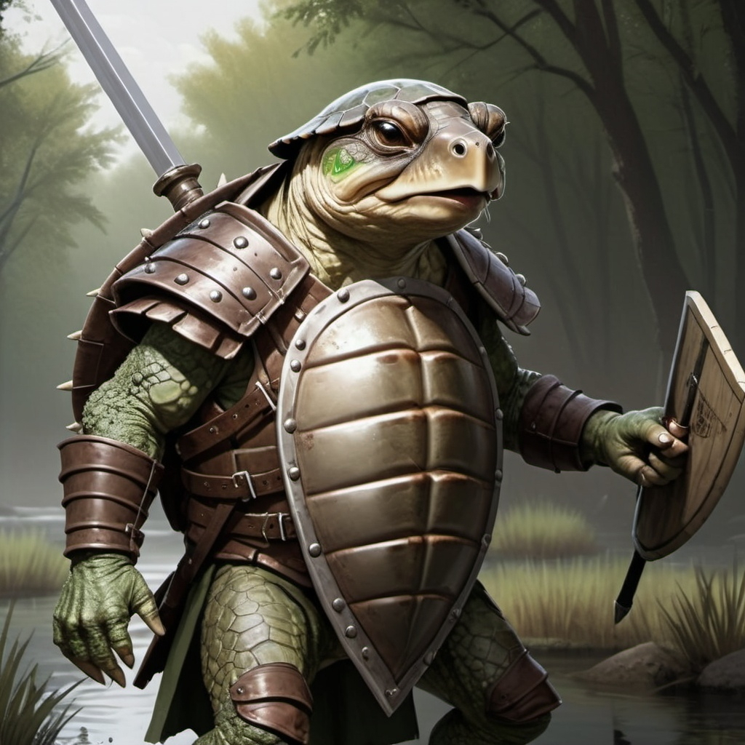
Testudin
Slow and steady wins the day in the mind of the Sloven kind. Though they are not weak fighters in combat many of the Sloven rely on the strength of their minds to see them through conflict situations. As crafters they are meticulous and detailed, some of the finest silversmiths and jewelers are among their kind.
They tend to be a peaceful people and would rather spend time learning and studding that wandering around the countryside. It is rare to find one out as an adventurer and can often frustrate the groups they are with because of the pace they set for themselves. Getting a Sloven to get to a point in negotiations or conversation can often be more challenging than most would want to deal with.
Hethle, Sloven Cartographer with his assistant Fetterday
Sloven Traits
Ability Score Increase: Your Wisdom increases by 2, Intelligence increases by 2
Age. Sloven generally live up to 750 years and mature around the age of 50.
Diet: Sloven are herbivorous
Alignment. Sloven tend toward the good alignments, but there have been rare evil Sloven throughout Thera
Size. Your size is Medium. You range between 5-6 feet tall and weigh around 125-200 lbs.
Speed. Your base walking speed is 15’ feet.
Reach. Your long arms have a reach of 10’
Slow Metabolism. You have resistance to poison damage
Darkvision. Accustomed to night life, you have superior vision in dark and dim conditions. You can see in dim light within 60 feet of you as if it were bright light, and in darkness as if it were dim light. You can't discern color in darkness, only shades of gray.
Meditative Mind. You have advantage on all Wisdom or Intelligence saves
Slow as F. Sloven have disadvantage on all Dexterity or Charisma saving throws and proficiency checks
Deliberate Movement. No class abilities, skills or feats can increase your movement rate.

